Slide 1
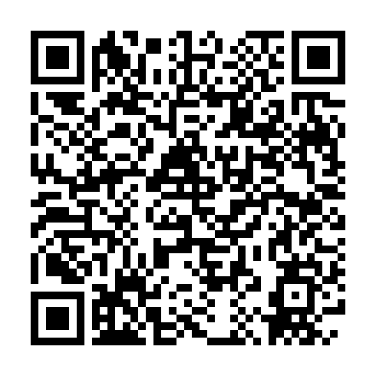
HOLYCRAB / AI ULTRA FESTIVAL
Vibe Filming
AI Video from Idea to Screen
AI 影片創作：從構想到成片
See what is possible. Learn the workflow. Make your first video.
Bruce Huang · AI Ultra Festival · Hong Kong · 13 September 2026
Vibe Filming / AI Ultra Festival / Revised 14 Sep 2026
01 / 20
Notes:
English-led event edition, revised after workshop feedback. Explain first, then hands-on. Keep the commercial context and ambitious examples; simplify the beginner execution path.
Mobile handout: https://brucehuang.ai/talks/ai-ultra-video-workshop-2026-09/cli-review/handout/slide-01.html

Slide 2
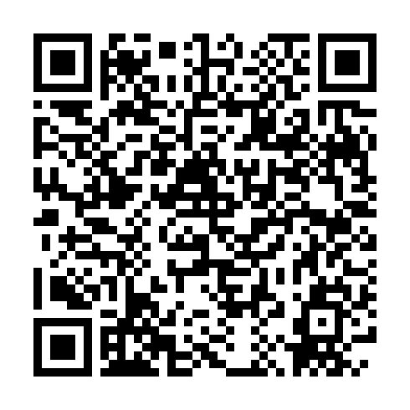
VIBE FILMING / AI ULTRA FESTIVAL
Why make an AI video?
把產品、人物與想法，變成觀眾看得懂的故事
01
Show a product in use, not just on a slide.
02
Reach customers through a presenter and their language.
03
Test a creative idea before a larger production.
Vibe Filming / AI Ultra Festival / Revised 14 Sep 2026
02 / 20
Notes:
Ask learners to pick one audience and one message. Our short product film connects the workshop to a practical marketing task, following group feedback about enterprise attendees.
Mobile handout: https://brucehuang.ai/talks/ai-ultra-video-workshop-2026-09/cli-review/handout/slide-02.html

Slide 3
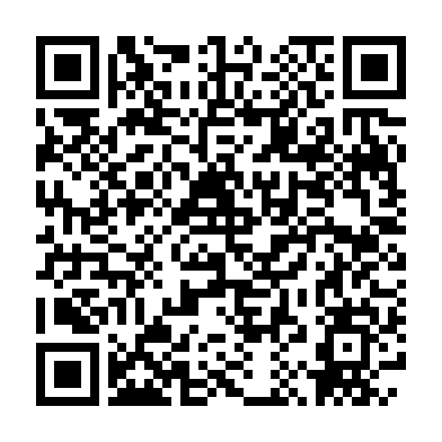
VIBE FILMING / AI ULTRA FESTIVAL
World-class ambition.
A workflow you can start.
先看高水準作品，再拆解成可操作的一小步
01
Watch the story, performance and visual consistency.
02
Look beyond a striking shot: assets, review and editing matter.
03
Start small; build toward that level of craft.
Vibe Filming / AI Ultra Festival / Revised 14 Sep 2026
03 / 20
Notes:
World-class describes our creative ambition, not a certified ranking or guarantee that a beginner prompt yields broadcast-ready work. Play the following industry and HolyCrab examples before teaching commands.
Mobile handout: https://brucehuang.ai/talks/ai-ultra-video-workshop-2026-09/cli-review/handout/slide-03.html

Slide 4
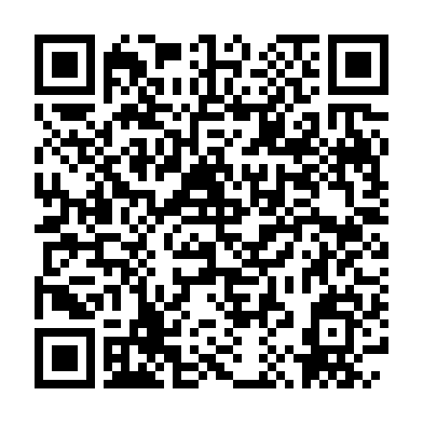
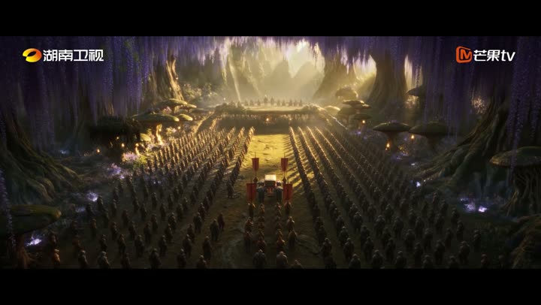
VIBE FILMING / CASE STUDY
AI drama on television
《后西游记》 · 成本、周期与市场反应
RMB 900k+ / episode
About 40 minutes; director claim, not audited
~3 months / 15 episodes
2 Sep interview; not all 30 episodes
Stock +44.03% / 2 sessions
28 Aug–1 Sep; media index +4.93%
Mango Excellent 300413.SZ · daily · RMB
08/28 schedule
22
18
Official Hunan TV trailer · 1080p · 30s
14
08-20
08-28
09-01
Official trailer and research sources in notes
09-08
Event-window move; causation is not established.
2026/08/20–09/08 · adjusted · red up / green down
Vibe Filming / AI Ultra Festival / Revised 14 Sep 2026
04 / 20
Notes:
00–04分钟开场内，播放30秒高清节选，说明AI影像已进入制作与播出流程。来源：湖南卫视官方B站账号，https://www.bilibili.com/video/BV181tP6KENt/ ，标题《【后西游记】首部AIGC长剧〈后西游记〉上星黄金档》。完整原预告139.584秒，本课使用00:00–00:30，视频流直接复制1920×1080源编码，不做降分辨率或视频重压缩，音频转为AAC96k并做极短淡入淡出。保留官方台标。替代此前合作伙伴PPT来源的540p压缩节选。这是第三方行业案例，不暗示HolyCrab制作该剧，也不推断制作模型、成本或收视率。
右侧数据取自Bruce在Codex任务《分析芒果TV AI影片商业数据》中完成的2026-09-09研究，本轮复核新京报导演专访和交易记录。这里是剧集，成本按单集而非整部电影：导演称每集九十多万元、每集约40分钟，非审计决算。导演9月2日称约三个月完成15集制作量，首批已播5集；平台另有首5集立项到上线约4个月的口径，两者范围和起点不同。不能称三个月完成全30集。公开资料未证明该剧使用Codex制作，已确认的是Bruce的研究在Codex完成。
制作专访：https://www.bjnews.com.cn/detail/1788401162168184.html
不同周期口径：https://www.eeo.com.cn/2026/0908/1028446.shtml
市场：芒果超媒300413.SZ，8月28日收盘14.15，9月1日20.38，累计44.03%，同期中证传媒4.93%。K线按2026-08-20至09-08的14个交易日OHLC绘制，沿用原研究窗口，不是当前实时行情。8月31日首次涨停早于当晚首播，不能将全部涨幅因果归于该剧；市值增量不等于公司现金或项目利润。
交易记录：https://finance.eastmoney.com/a/202609013861493595.html
历史行情：https://web.ifzq.gtimg.cn/appstock/app/fqkline/get?param=sz300413,day,2026-08-20,2026-09-08,320,qfq
搜狐交叉核对：https://q.stock.sohu.com/hisHq?code=cn_300413&start=20260820&end=20260908&stat=1&order=A&period=d
Mobile handout: https://brucehuang.ai/talks/ai-ultra-video-workshop-2026-09/cli-review/handout/slide-04.html

Slide 5
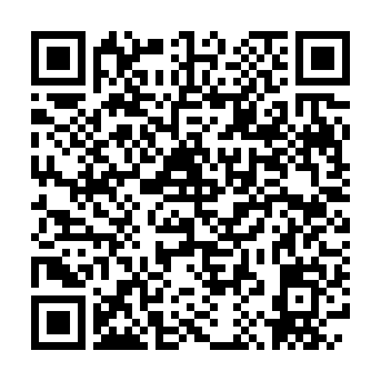
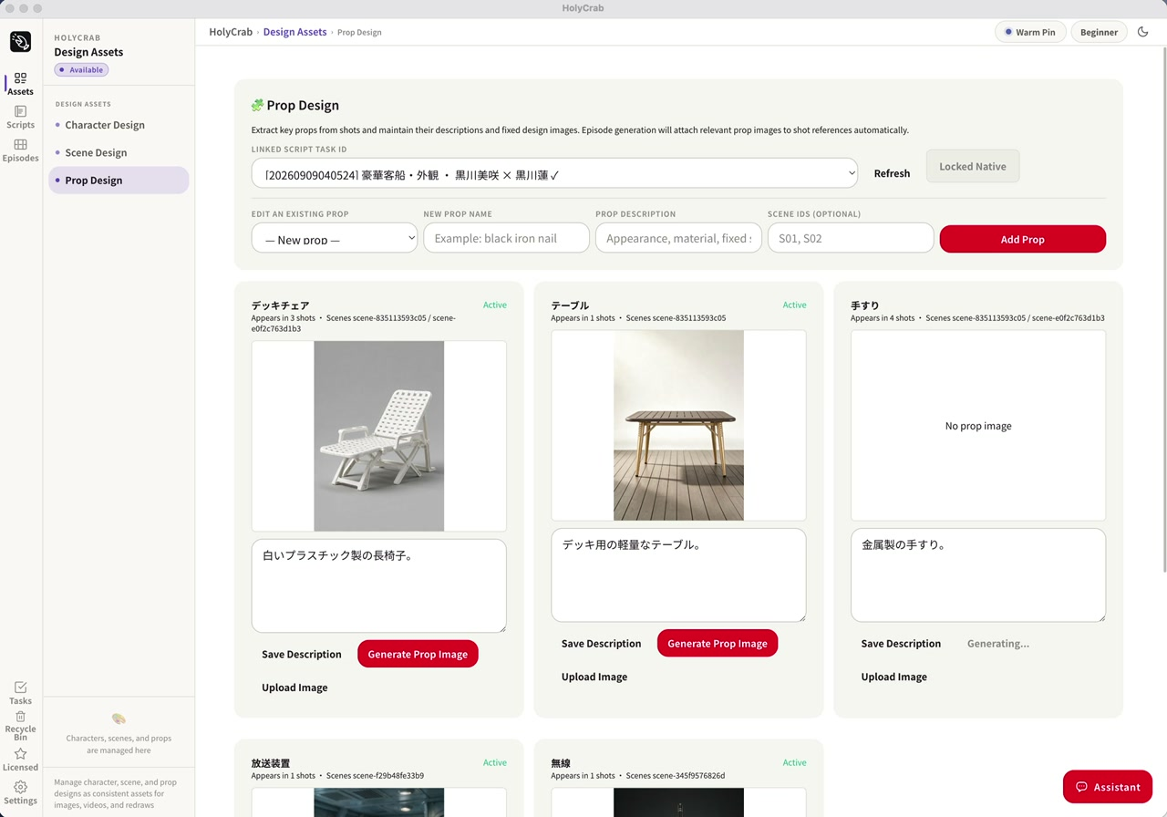
HOLYCRAB / PRODUCTION
A production system,
not just a prompt
從劇本、角色、場景到鏡頭，保留每一次製作決策
HolyCrab production workflow · actual system screenshot
Vibe Filming / AI Ultra Festival / Revised 14 Sep 2026
05 / 20
Notes:
03:45–05:00。说明制作链条：剧本、角色设计、场景设计、道具设计、镜头生成和审片。截图来自合作方演示文稿中的实际制作系统，用于展示制作流程，不承诺每个账号都能使用这套桌面系统。课堂实操使用公开网页生成器。来源：合作方演示文稿第9页。
教学设计待补充：老师示范____；学员动作____；完成标准____。
Mobile handout: https://brucehuang.ai/talks/ai-ultra-video-workshop-2026-09/cli-review/handout/slide-05.html

Slide 6
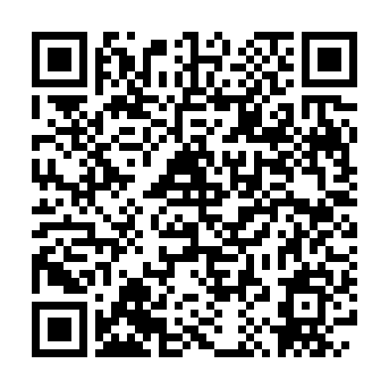
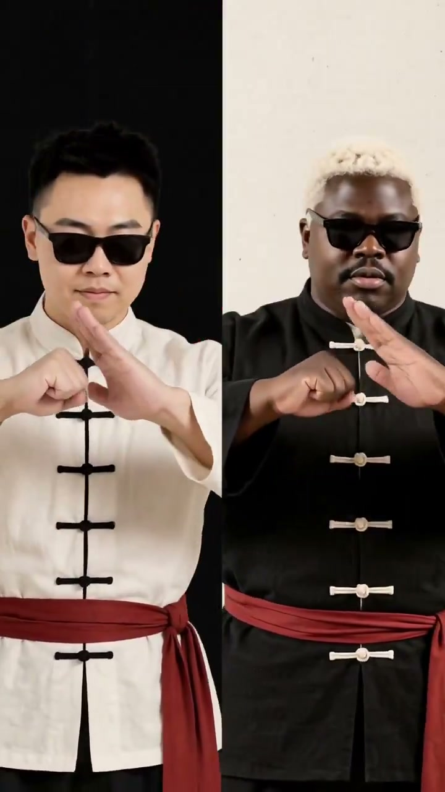
VIBE FILMING / CASE STUDY
Performance meets rhythm
表演、節奏與風格：HolyCrab 音樂影片案例
HolyCrab H3 music video · 30-second excerpt
打开视频播放
视频页内嵌 MP4；下方链接为联网备用
Vibe Filming / AI Ultra Festival / Revised 14 Sep 2026
06 / 20
Notes:
开场可选短放15–30秒，Bruce最终选示范。带声音播放前30秒，再用30秒拆解创作。观察两位表演者、黑白服装与红色腰带、统一的图形色彩，以及近景、中景和全身景别之间的剪辑。HolyCrab 帖文注明使用 MiniMax H3，但未公开全部制作步骤，也未声称整片由一次生成完成。可讲解表演、重复使用的视觉素材和随音乐剪辑的作用，不要编造原始提示词。完整视频61.416秒，见学员手册。来源：https://x.com/holycrabAI/status/2098092554093039735 。这是 HolyCrab 发布的模型示例，不应称为艺人官方委托作品。
教学设计待补充：老师示范____；学员动作____；完成标准____。
Mobile handout: https://brucehuang.ai/talks/ai-ultra-video-workshop-2026-09/cli-review/handout/slide-06.html
Video poster and linked playback: https://brucehuang.ai/talks/ai-ultra-video-workshop-2026-09/assets/holycrab-h3-mv.mp4. HTML toolkit embeds the local video. Final PPTX includes embedded MP4 with a browser-link fallback.

Slide 7
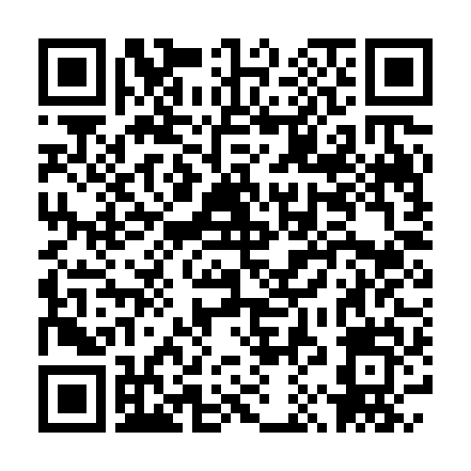
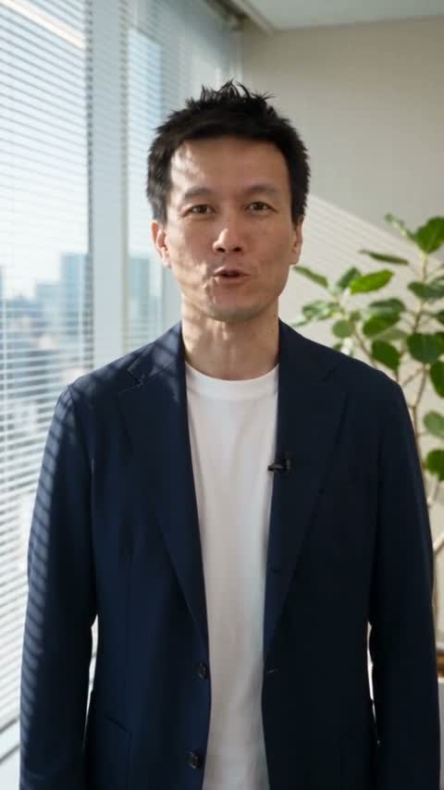
VIBE FILMING / CASE STUDY
A real introduction.
In Japanese.
真實商務用途：Bruce 在日本客戶現場的自我介紹
Bruce introducing himself in Japanese · 34 seconds
打开视频播放
视频页内嵌 MP4；下方链接为联网备用
Vibe Filming / AI Ultra Festival / Revised 14 Sep 2026
07 / 20
Notes:
Play Bruce’s 34-second Japanese introduction used with clients in Japan. This is a business-use example, not the beginner exercise or reusable learner identity. Do not infer its production model or claim a single generation. The hands-on route is one 10-second web video, one Codex video, then optional continuation. Real-person uploads require the owner’s verification.
Mobile handout: https://brucehuang.ai/talks/ai-ultra-video-workshop-2026-09/cli-review/handout/slide-07.html
Video poster and linked playback: https://brucehuang.ai/talks/ai-ultra-video-workshop-2026-09/assets/bruce-japanese-intro.mp4. HTML toolkit embeds the local video. Final PPTX includes embedded MP4 with a browser-link fallback.

Slide 8
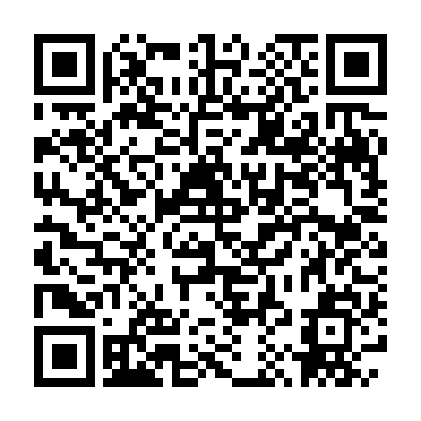
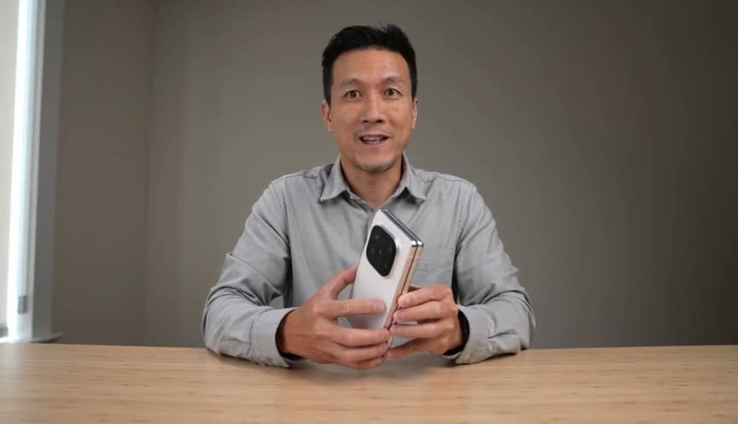
HOLYCRAB WORKSHOP
One person. One product.
A finished 30-second film.
先看成品：人物、商品與兩段銜接
Seedance 2.0 Fast
15s + 15s · English audio
Advanced demo.
Our first exercise is one simple 10s clip.
Open video
Vibe Filming / AI Ultra Festival / Revised 14 Sep 2026
08 / 20
Notes:
Actual workshop output from vibe-filming workshop, generated2026-09-13. A task64eb9e33cb02494fa72090cba210195d and B taskc4d5f2a402964869afa36b0c65a0b350,85credits each. Actual output864x496,30.336seconds after local audio muxing, requested16:9. Both native audio tracks preserved; local loudness correction A-18.08/B-18.02LUFS. Local ASR recognized the approved English copy; direct human assessment of voice identity and lip sync still needed. Visible limitations: phone covers lower face, extra inner-screen camera holes, reference wallpaper copied, B push-in crops phone. This is an AI concept/workflow demonstration, not an official Apple ad or a product-accuracy endorsement.
Mobile handout: https://brucehuang.ai/talks/ai-ultra-video-workshop-2026-09/cli-review/handout/slide-08.html

Slide 9
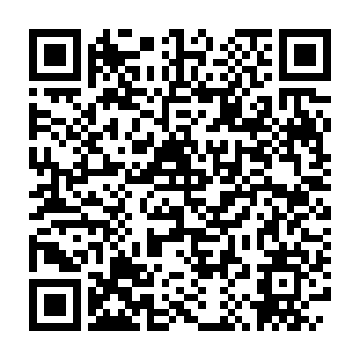
VIBE FILMING / AI ULTRA FESTIVAL
What makes this repeatable?
看完成品，再看原始 Prompt 與參考照片
01
Person asset: who appears. Product asset: what it looks like.
02
Prompt: what happens, in what style, with what voice.
03
Last frame: where the next shot begins.
Vibe Filming / AI Ultra Festival / Revised 14 Sep 2026
09 / 20
Notes:
The linked source page contains the actual inputs and submitted prompts for the finished demo. These are distinct from the simpler 10-second beginner exercise. Real-person assets require their owner’s verification; do not reuse Bruce as your identity.
Mobile handout: https://brucehuang.ai/talks/ai-ultra-video-workshop-2026-09/cli-review/handout/slide-09.html

Slide 10
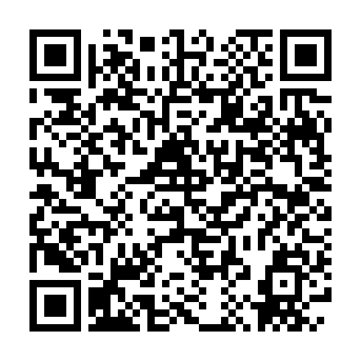
VIBE FILMING / AI ULTRA FESTIVAL
Why use a coding agent?
你決定創意；Codex 負責執行與保留製作記錄
01
Turn a brief into prompts and API requests.
02
Check costs, track tasks and download the result.
03
Reuse assets and continue a project without starting over.
Vibe Filming / AI Ultra Festival / Revised 14 Sep 2026
10 / 20
Notes:
HolyCrab CLI calls the generation API. The agent handles file operations and task tracking; the learner approves creative choices and each paid submission. First learn the generation loop on the website.
Mobile handout: https://brucehuang.ai/talks/ai-ultra-video-workshop-2026-09/cli-review/handout/slide-10.html

Slide 11
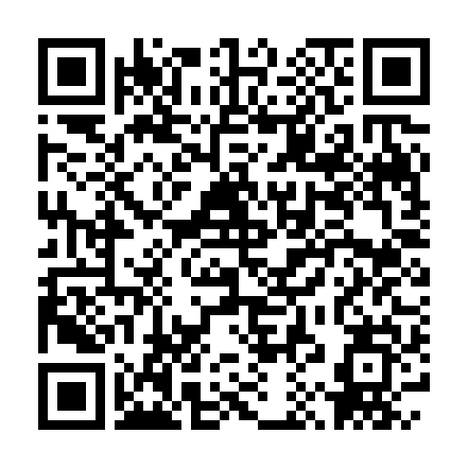
VIBE FILMING / AI ULTRA FESTIVAL
Optional: see the canvas
同事示範 5–10 分鐘，學員只需觀看
01
Prepared assets → connected generation nodes → result.
02
A colleague shows one change in a prepared project.
03
Then Bruce returns to the step-by-step workflow.
Vibe Filming / AI Ultra Festival / Revised 14 Sep 2026
11 / 20
Notes:
Optional slot within the first 30 minutes. Use the colleague’s prepared live canvas and result. No verified screenshot is bundled; this is an agenda placeholder. If skipped, use the time to discuss examples. Do not imply canvas and CLI projects automatically sync.
Mobile handout: https://brucehuang.ai/talks/ai-ultra-video-workshop-2026-09/cli-review/handout/slide-11.html

Slide 12
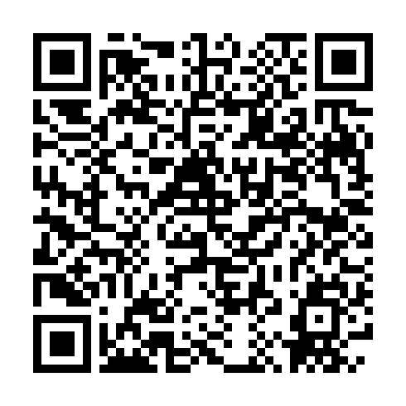
VIBE FILMING / AI ULTRA FESTIVAL
First understand.
Then make.
前半場解說，後半場循序動手
01
00–30: why video, cases, assets and optional canvas.
02
30–40: website first. 40–50: one video with Codex.
03
50–55: optional frame continuation. 55–60: questions.
Vibe Filming / AI Ultra Festival / Revised 14 Sep 2026
12 / 20
Notes:
Rendering times vary. Stage 3 is a walkthrough if prior clips are still queued; finish later without resubmitting. Late arrivals start at Stage 1. People without Codex can complete the web exercise and follow the later demo.
Mobile handout: https://brucehuang.ai/talks/ai-ultra-video-workshop-2026-09/cli-review/handout/slide-12.html

Slide 13
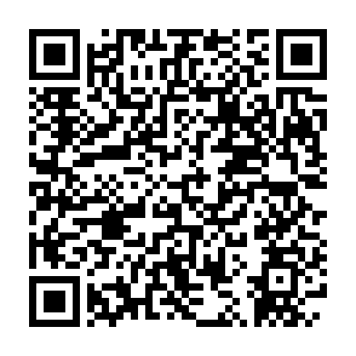
VIBE FILMING / AI ULTRA FESTIVAL
Make your first video on the web
第一步：先在網頁完成一條，不用安裝或配置 Key
PROMPT 1 / 3 · 10 minutes
1. Sign in to HolyCrab and check your credits.
2. Open text-to-video and paste this prompt.
3. Select 2.0 Fast / 480p / 10s / 16:9 + audio; review the quote, then generate.
Done: play it, hear the voice, and download it. Queued is not finished.
SCAN · COPY · RUN
Open prompt 1
Vibe Filming / AI Ultra Festival / Revised 14 Sep 2026
13 / 20
Notes:
Create a 10-second, 16:9 realistic social video with native audio. One original virtual adult creator in a plain navy shirt sits at a light-oak desk. Soft daylight, warm neutral background. This is a fictional person, not a celebrity or a real person's likeness.
A generic unbranded smartphone is already in the creator's hands, below the face. In one steady medium shot, the creator raises the phone slightly toward the camera and smiles. Keep the face, both hands and the entire phone visible. One person, one phone, one simple movement. No unfolding, screen interaction, scene changes, captions or music.
Between seconds 1 and 7, say in natural, upbeat English: "One idea. One prompt. Let's make it real." Quiet room tone. Hold still with the phone clearly visible during the final two seconds. No additional speech.
Mobile handout: https://brucehuang.ai/talks/ai-ultra-video-workshop-2026-09/cli-review/prompts/1.html

Slide 14
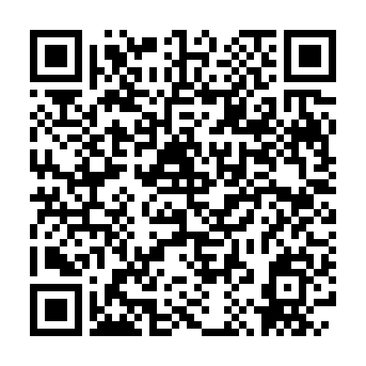
VIBE FILMING / AI ULTRA FESTIVAL
One playable result
is the first milestone
完成第一條，再增加難度
01
Queued? Keep the task. Do not click Generate again.
02
Completed? Watch the person and phone; listen to the line.
03
Download it. Change only one thing on the next attempt.
Vibe Filming / AI Ultra Festival / Revised 14 Sep 2026
14 / 20
Notes:
Use an original virtual presenter and generic phone. No real-person verification, Apple asset download or CLI installation is required for the first win. Phone-only learners can participate on the website.
Mobile handout: https://brucehuang.ai/talks/ai-ultra-video-workshop-2026-09/cli-review/handout/slide-14.html

Slide 15
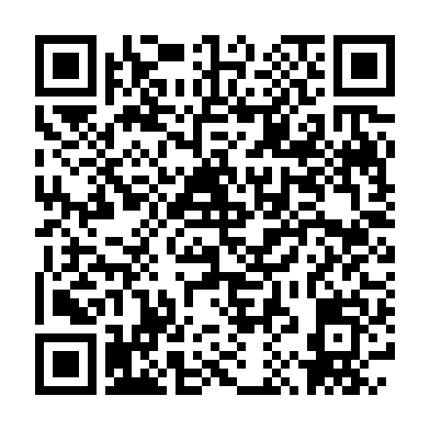
VIBE FILMING / AI ULTRA FESTIVAL
One project.
One private chat.
不用先學 Terminal；等待 Agent 提示，再貼測試 Key
01
Open a vibe-filming project in Codex.
02
Create a limited test key in your HolyCrab account.
03
Paste it into the same private Codex chat only when asked.
Vibe Filming / AI Ultra Festival / Revised 14 Sep 2026
15 / 20
Notes:
Do not project the key or paste it into the public handout or group. It remains in private chat history; revoke the test key after practice. If installation or company permissions block you, stay on the website and ask staff. No learner PATH editing or security bypass. Official CLI https://holycrab.ai/cli/ .
Mobile handout: https://brucehuang.ai/talks/ai-ultra-video-workshop-2026-09/cli-review/handout/slide-15.html

Slide 16
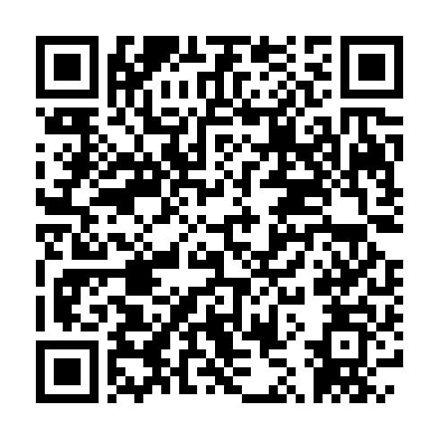
VIBE FILMING / AI ULTRA FESTIVAL
Let Codex make one video
第二步：同一專案、同一私人聊天視窗
PROMPT 2 / 3 · 10 minutes · Codex-ready learners
1. Open a vibe-filming project in Codex.
2. Paste the instructions; provide a new limited test key only when asked.
3. Approve the quote. Generate and save one A.mp4.
Done: a playable A.mp4 with audio, its prompt, task ID and actual cost.
SCAN · COPY · RUN
Open prompt 2
Vibe Filming / AI Ultra Festival / Revised 14 Sep 2026
16 / 20
Notes:
Help me generate one video with HolyCrab. I am a beginner. Give me only one action to take at a time.
1. Check local command access and whether HolyCrab CLI is available. Follow the current official instructions at https://holycrab.ai/cli/ . If installed but not found, inspect the installation path and use the verified executable path. Do not ask me to edit PATH, disable security, or bypass company policies. Explain any permission I must approve in one sentence. If blocked, explain why and let me continue on the website.
2. Check for an existing usable local API key. If missing, pause and ask me to paste a newly created, limited test key into this same private Codex chat. I will paste it here; do not require Terminal. Do not echo it. Use the official configuration method; never put it in project files, prompts, logs, or Git. Do not claim the key has disappeared from chat history.
3. Read current model capabilities. Use Seedance 2.0 Fast, 10 seconds, 480p, 16:9, text-to-video with native audio and the prompt below. If unsupported, explain first; do not silently switch models. Show the actual quote, account balance and cumulative exercise cost. Wait for my explicit confirmation, then submit exactly once. Approval does not include automatic retries. Recover the existing task after a disconnect rather than submitting again.
4. Download output/A.mp4. Save the prompt and task ID. Check duration and audio, and tell me where to play it. Generate only this one clip: do not extract frames, continue, or assemble yet. Clearly say if the task is still queued.
VIDEO PROMPT:
Create a 10-second, 16:9 realistic social video with native audio. One original virtual adult creator in a plain navy shirt sits at a light-oak desk. Soft daylight, warm neutral background. This is a fictional person, not a celebrity or a real person's likeness.
A generic unbranded smartphone is already in the creator's hands, below the face. In one steady medium shot, the creator raises the phone slightly toward the camera and smiles. Keep the face, both hands and the entire phone visible. One person, one phone, one simple movement. No unfolding, screen interaction, scene changes, captions or music.
Between seconds 1 and 7, say in natural, upbeat English: "One idea. One prompt. Let's make it real." Quiet room tone. Hold still with the phone clearly visible during the final two seconds. No additional speech.
Mobile handout: https://brucehuang.ai/talks/ai-ultra-video-workshop-2026-09/cli-review/prompts/2.html

Slide 17
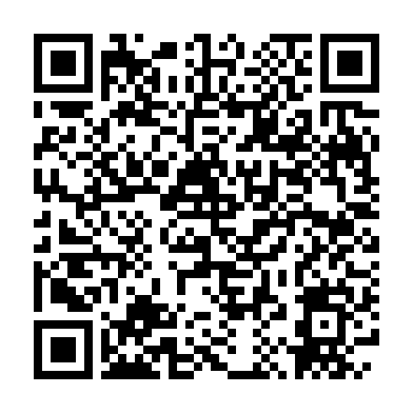
VIBE FILMING / AI ULTRA FESTIVAL
Stuck? Diagnose.
Do not regenerate.
安裝、Key、排隊：一次只排查一個問題
01
Command not found: ask the agent to check its install path.
02
Invalid key: check the full key, limit and revocation status.
03
No result: retrieve the existing task ID before retrying.
Vibe Filming / AI Ultra Festival / Revised 14 Sep 2026
17 / 20
Notes:
Copy this into Codex: Diagnose the current error only. Tell me which window needs my next action. Do not generate again, reinstall repeatedly, or display my key. Share only redacted errors with staff. Company permission issues go to IT.
Mobile handout: https://brucehuang.ai/talks/ai-ultra-video-workshop-2026-09/cli-review/handout/slide-17.html

Slide 18
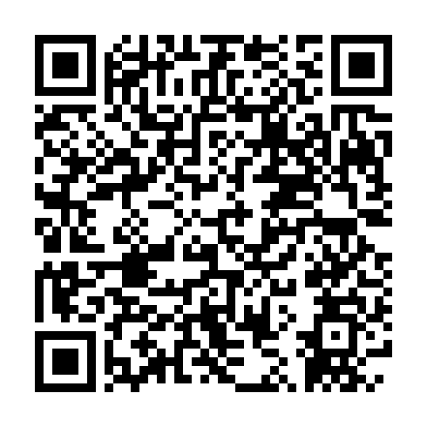
VIBE FILMING / AI ULTRA FESTIVAL
Continue from the last frame
第三步：進階選做，先有成片才做續接
PROMPT 3 / 3 · 5-minute walkthrough · finish after rendering
1. Open the completed A.mp4 and inspect its ending.
2. Extract the actual last frame; upload it and wait for ready.
3. Approve a fresh quote, generate B, then join and inspect.
Done: keep A, bridge.png, B and final.mp4. Watch and listen across the join.
SCAN · COPY · RUN
Open prompt 3
Vibe Filming / AI Ultra Festival / Revised 14 Sep 2026
18 / 20
Notes:
Continue in the same project. This is optional advanced work. Do not submit anything without a playable A.mp4. Reuse output/A.mp4 from Stage 2, or ask for the downloaded Stage 1 video. Do not regenerate A just to start this stage.
1. Open A and inspect the face, hands and phone at the ending. After I accept it, extract its actual last frame to assets/bridge.png and show it to me. If an earlier frame is needed, trim A to exactly that frame and record why; never silently replace the ending.
2. This exercise defaults to an original virtual person. Upload the frame with the current official CLI and wait for ready. Record its source task. If A contains a real person, keep the derived frame in that person's original verified group. Stop if verification fails; never bypass it with an ordinary upload.
3. Read the current Seedance 2.0 Fast first-frame parameters. Use the bridge as firstFrameAssetId for a 10-second, 480p B with native audio. Use adaptive aspect ratio as required by the current frames mode; do not mix in a reference-image array. Use the prompt below. Show the quote, balance and cumulative exercise cost. Wait for explicit confirmation and submit once. No automatic retry or top-up.
4. Download output/B.mp4 and check that it starts from the supplied frame. Assemble A then B locally into output/final.mp4, retaining originals, audio and both task IDs. Do not overwrite A or B. Let me watch and listen to two seconds on either side of the join: person, phone, movement and volume. A frame helps visual continuity but cannot guarantee the same voice. Report missing native audio as a problem, not a completed silent video.
VIDEO PROMPT:
Continue the supplied first frame as a 10-second video with native audio. Preserve the same virtual creator, face, navy shirt, hands, unbranded phone, desk, lighting and phone orientation. The phone is already raised; do not repeat that action.
Seconds 0–3: hold the opening composition. Seconds 3–8: one slow, straight camera push toward the phone, keeping the entire phone and supporting fingers in view. Seconds 8–10: hold still. Do not change the phone, unfold it, cut to another angle, or add captions or music.
Use a warm English off-screen voiceover between seconds 1 and 7: "Now take it one step further. Keep creating." The visible mouth remains relaxed and closed. Quiet room tone. Keep the final two seconds free of speech. Match the previous clip's vocal character if possible; the visual frame does not guarantee the same voice.
Mobile handout: https://brucehuang.ai/talks/ai-ultra-video-workshop-2026-09/cli-review/prompts/3.html

Slide 19
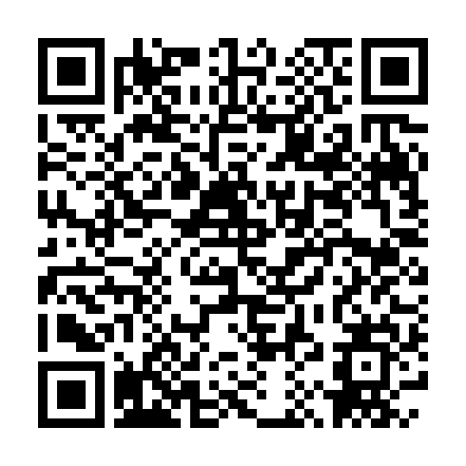
VIBE FILMING / AI ULTRA FESTIVAL
Keep the work.
Build on it.
保留影片、Prompt、素材與任務 ID
01
Save A, the bridge frame, B and the assembled film.
02
Check picture and voice across the join.
03
Website and API use the same credit pricing; quote each next task.
Vibe Filming / AI Ultra Festival / Revised 14 Sep 2026
19 / 20
Notes:
No need to exhaust 500 credits. Actual cost depends on the model, duration, resolution and inputs. The earlier 15s+15s Seedance demo used 170 credits, not a fixed price promise for this exercise. Ask for a fresh quote; any top-up is the learner’s choice. A frame does not guarantee voice identity.
Mobile handout: https://brucehuang.ai/talks/ai-ultra-video-workshop-2026-09/cli-review/handout/slide-19.html

Slide 20
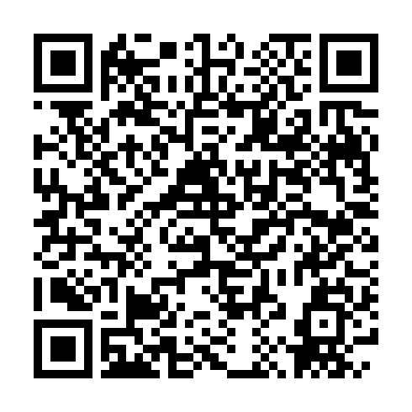
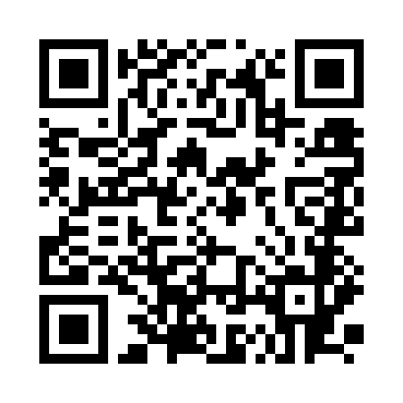
VIBE FILMING / LIVE WORKSHOP
Keep creating.
We are here to help.
Workshop community · continue learning
1. Join the HolyCrab workshop WhatsApp group.
2. Share your stage, question and a redacted error if needed.
3. Continue with your existing credits and saved project.
SCAN TO JOIN
Open WhatsApp group
Vibe Filming / AI Ultra Festival / Revised 14 Sep 2026
20 / 20
Notes:
Original workshop offer: 500 credits × 50 places. Ask staff about eligibility and availability; do not promise fresh credits after the event. Keep the provided group link unchanged.
Mobile handout: https://brucehuang.ai/talks/ai-ultra-video-workshop-2026-09/cli-review/handout/slide-20.html

