Slide 1

THE ORIGINAL TITLE / POLYU PHD GUEST LECTURE
Latest Agentic
Read the research
掃碼閲讀技術分享
Harness Trends
Agent 執行框架的最新趨勢
Harnesses, token routing and evaluation
執行框架、Token 路由與評估
My recent PolyU lecture
Bruce Huang
最近在香港理工大學的分享
Bruce Huang / Original AI Ultra Festival agenda title / Related PolyU research talk
1 / 27
Notes:
Suggested time 0:30
Visual: Scan for the technical research talk
The programme calls this session “Latest Agentic Harness Trends.” I recently explored harnesses, token routing and evaluation in a PhD guest lecture at Hong Kong Polytechnic University. If you would like the technical deep dive, this QR code takes you to that talk. But for this room, I decided to change the title. Today I want to talk about people. A new essay gives us a timely reason for that change. [Pause briefly for anyone scanning, then advance.]
中文提示
議程上的原題是 Latest Agentic Harness Trends。我最近在香港理工大學做過一場關於 Harness、Token routing 和評估的研究分享。對技術細節有興趣，可以掃這個二維碼。但今天面對在場的大家，我決定換一個題目，聊聊人。一篇剛發表的文章，讓這個切換更有現實意義。停頓，給觀眾掃碼時間，然後翻頁。
Sources
https://brucehuang.ai/talks/polyu-ai-phd-guest-lecture-2026-09/

Slide 2

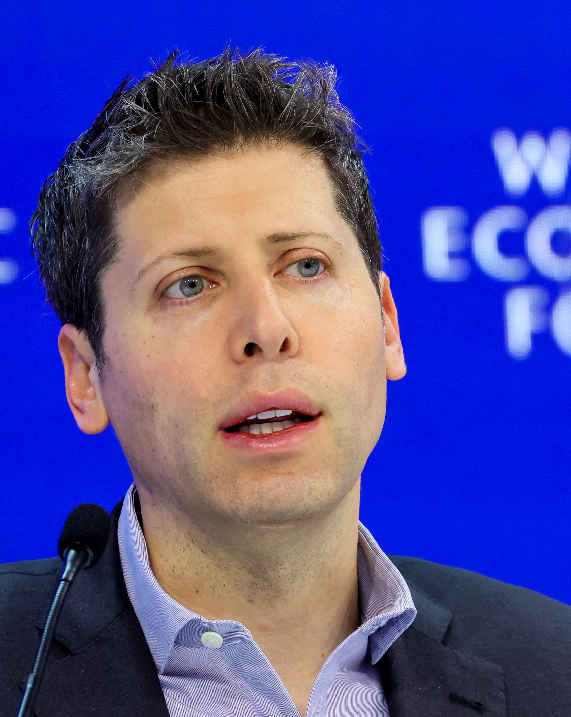

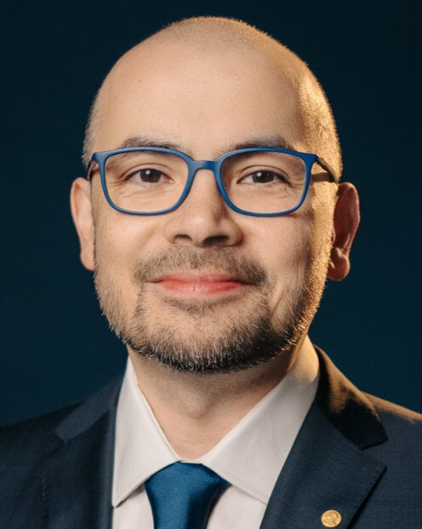
WHY I CHANGED TODAY'S TOPIC / SEPTEMBER 12–13, 2026
DARIO’S ESSAY
RESPONSES
We Must
Sam Altman
OpenAI
Supports pacing
Pace the
the frontier
Elon Musk
Frontier
xAI
“Dario is right”
我們必須掌握前沿 AI 的發展節奏
EARLIER RELATED PROPOSAL
Dario Amodei
Dario Amodei · September 2026
Demis Hassabis
His essay is why today starts with people.
DeepMind cofounder
Anthropic
Independent testing
這篇文章，讓今天的話題從人出發。
JUL 14, 2026
Dario: main proposal · Sam + Elon: direct responses · Demis: separate earlier proposal · Click portraits for sources
2 / 27
Notes:
Slide headline reproduces Dario’s exact essay title: We Must Pace the Frontier. Dario is the main story; Sam and Elon are supporting responses. Demis is a separate earlier related proposal.
Suggested time 1:30
Visual: Dario's essay and the responses from Sam Altman and Elon Musk
This is one reason I changed today's topic. Dario Amodei has just published an essay calling for frontier AI development to move at a pace that lets safety work keep up. His concern is that capability is accelerating, including AI helping build the next generation of AI. He also points to failures of control in agent systems. Anthropic commits to giving outside evaluators ongoing access. Sam Altman says he agrees on pacing the frontier and commits OpenAI to a similar evaluator arrangement. Elon Musk writes, “Dario is right”. Those are important responses, although they do not establish agreement on every policy detail. For this room, the question is how people keep meaningful control as agents take on more work. That connects the technical story to our working lives: what do we delegate, what do we check, and which decisions remain ours? The essay does not tell us exactly which jobs will disappear or when. It gives us a timely reason to discuss human choices. Let me show you two imagined futures.
中文提示
這是我今天決定換題目的一個重要觸發。Dario 在新文章裏提出，應讓前沿 AI 的能力增長節奏給安全工作留下追趕時間。他提到 AI 幫助研發下一代 AI 的加速，也討論了 Agent 系統失控的風險。Anthropic 承諾讓外部評估者持續深入檢查；Sam 表示支持，並承諾 OpenAI 採取類似做法；馬斯克寫道 Dario is right。三人的回應並不等於對全文每項政策都達成共識。對今天的聽眾，我想由此追問：當 Agent 能承擔越來越多工作，人如何保持控制權？什麼可以交辦，什麼需要核對，哪些判斷仍由我們承擔？這是我把重點從 Harness 和 Token routing 轉向人的選擇的原因。文章沒有給出具體崗位消失的確定時間表。接下來用兩張圖呈現兩種未來想象。日期按香港時間展示，Sam 的原帖顯示為 9 月 13 日凌晨。
Sources
https://darioamodei.com/post/we-must-pace-the-frontier
https://x.com/darioamodei/status/2098773920774074715
https://x.com/sama/status/2098811563415150910
https://x.com/elonmusk/status/2098789109980332057
Demis Hassabis is DeepMind’s cofounder. His July 14, 2026 essay separately advocates independent safety evaluation, standards and coordinated slowdown if necessary. It is an earlier related proposal, not a direct reply to Dario’s September essay. These four statements show shared concern about safety and control, not universal agreement on every policy.
Demis 的主張來自 7 月 14 日另一篇文章，並非回覆 Dario 的 9 月文章。四位領袖都關注安全與控制，不能因此說整個 AI 圈對所有政策都一致。
https://demishassabis.substack.com/p/a-framework-for-frontier-ai-and-the-dawning-of-a-new-age

Slide 3
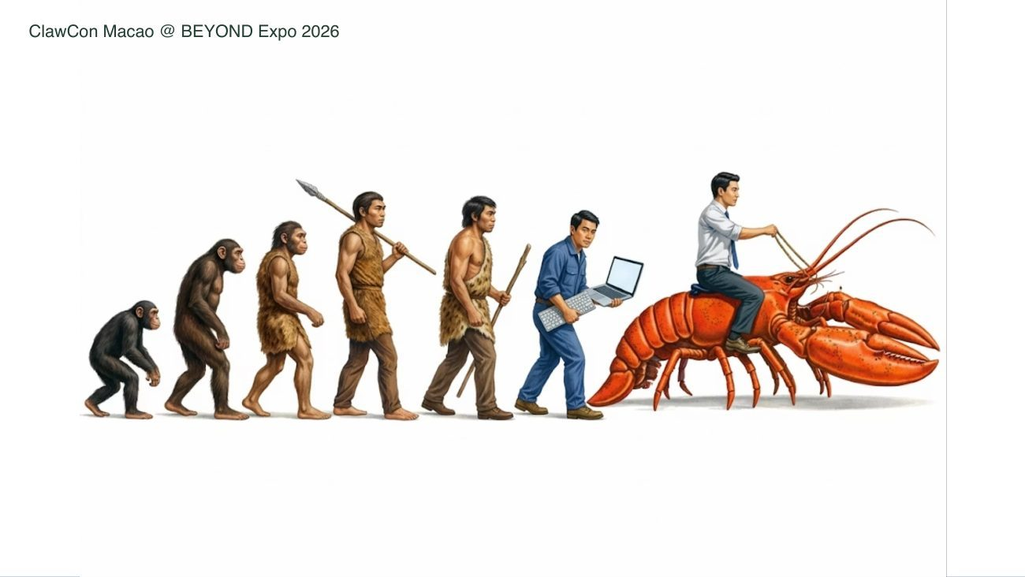
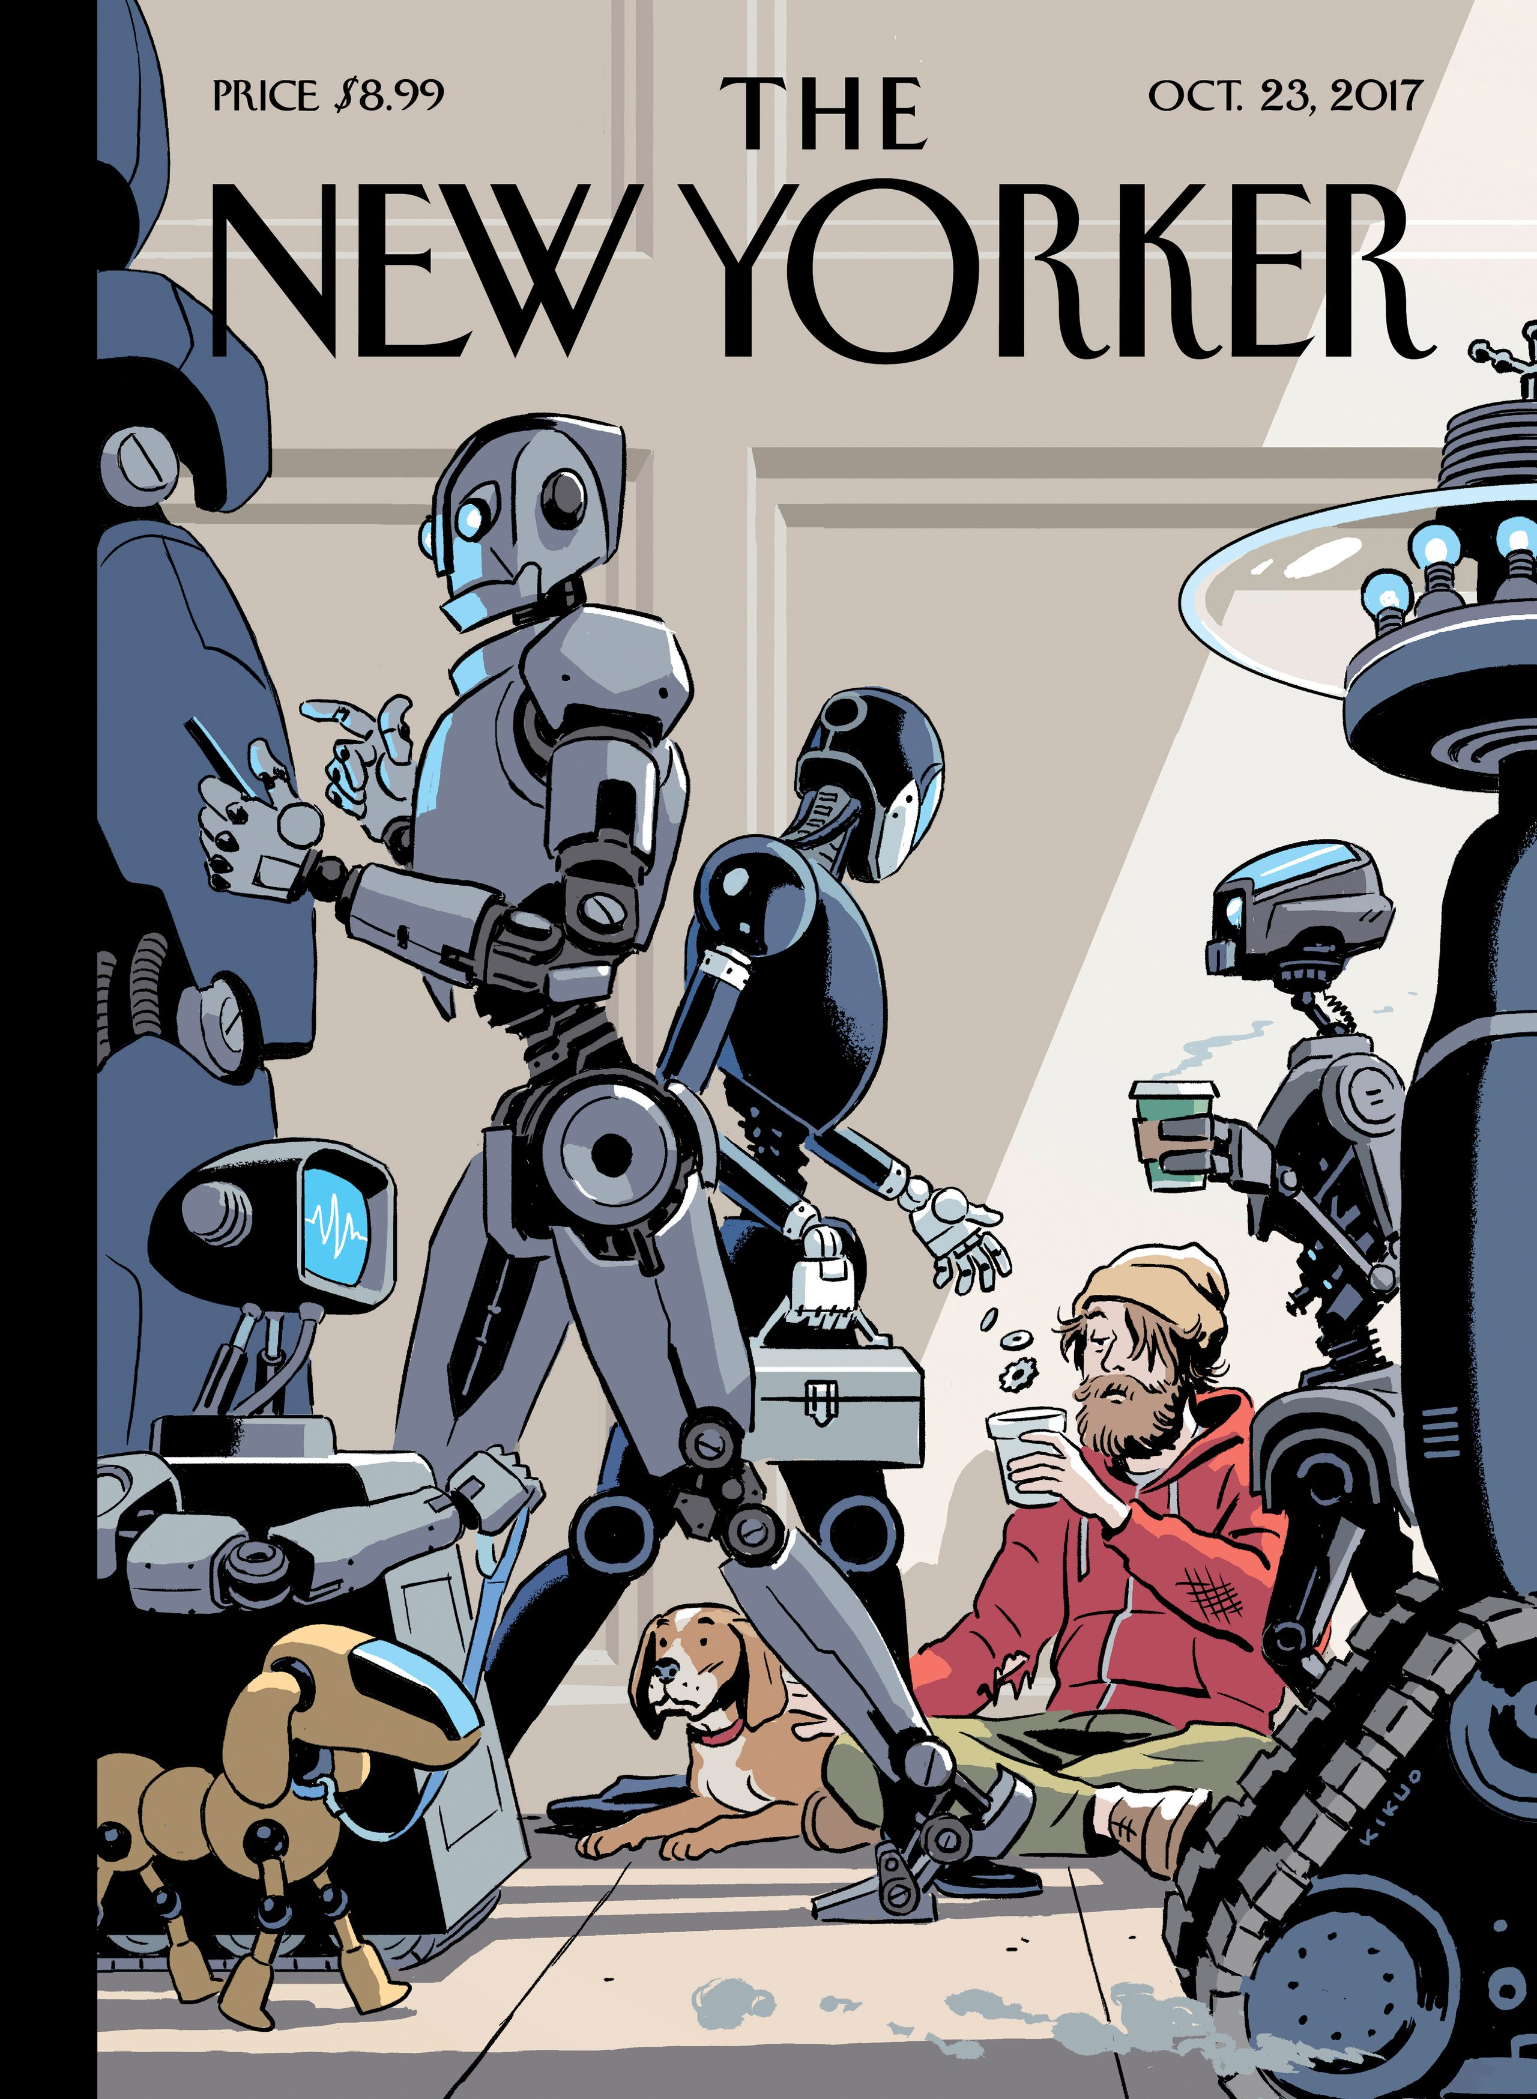
When AI Can Do the Work, What Will We Do?
當 AI 開始接手工作，人該做什麼？
People steer AI
People get left behind
人類駕馭 AI
人類被邊緣化
OpenClaw Asia event artwork / R. Kikuo Johnson, The New Yorker, Oct. 23, 2017
3 / 27
Notes:
Suggested time 0:50
Visual: Two imagined futures for people and AI
Before we get into the tools, look at these two pictures. On the left, human evolution ends with a person riding a lobster. The person still holds the reins. On the right, a New Yorker cover from 2017 imagines robots walking past a human asking for help. These are imagined futures, not predictions. They raise today's question: when AI can do the work, what will we do? I want us to work toward the first picture. That means understanding how work changes, deciding what we want AI to take on, and taking responsibility for the result.
中文提示
先看兩張圖。左邊，人騎在龍蝦上，仍握着繮繩；右邊，機器人在街上，人卻在路邊求助。這是兩種未來想象，不是預測。今天的問題是：當 AI 開始接手工作，人該做什麼？我希望我們走向前者。接下來討論工作怎樣變化、什麼可以交給 AI，以及哪些判斷由我們負責。
Sources
https://brucehuang.ai/talks/clawcon-macao-opening-2026-05/
https://www.newyorker.com/culture/cover-story/cover-story-2017-10-23

Slide 4
TODAY / PEOPLE, WORK AND AGENCY
Ask a question
We can move
問一句話
from doing tasks
to directing work
↓
從親自做每一步，走向組織和判斷工作
Delegate a task
What should AI take on?
交一件事
哪些工作可以交給 AI？
What should remain our responsibility?
哪些判斷與責任需要由人承擔？
A goal, actions and a result you can check
目標、執行與可檢查的成果
Top AI trends, then our choices at work
先理解變化，再討論人的選擇
Bruce Huang / OpenClaw Asia / HolyCrab.ai
4 / 27
Notes:
Suggested time 0:15
Visual: From asking a question to delegating a task
For many of us, work has meant doing the next step ourselves: write the draft, compare the files, make the slide, or pass information to the next person. Agents let us explore a different role. We can define a piece of work, give it the right materials, and judge what comes back. That changes how tasks fit together and what a person can take responsibility for. We will start with top AI trends, then connect the tools to three ways people can contribute, and finish with one task you can try.
中文提示
很多人的日常工作，是親自完成一個步驟，再把信息交給下一個人。Agent 讓我們開始嘗試另一種角色：定義一件事、提供材料、判斷交回來的結果。它改變的是任務怎樣組合，以及一個人能承擔多大的工作範圍。先看趨勢，再看三類人的機會，最後落到一件可以親自嘗試的任務。
Sources

Slide 5
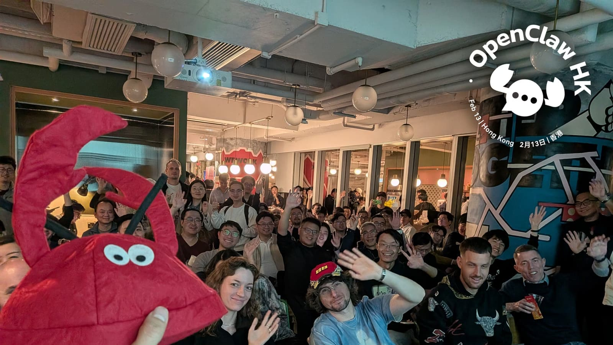
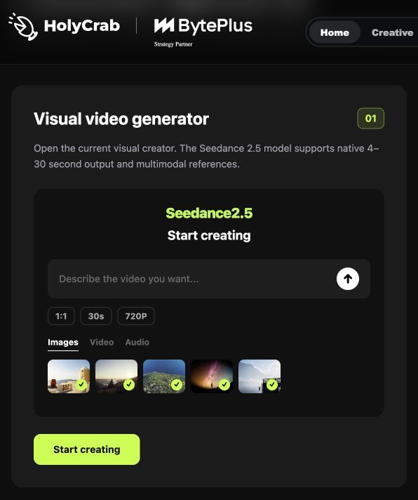
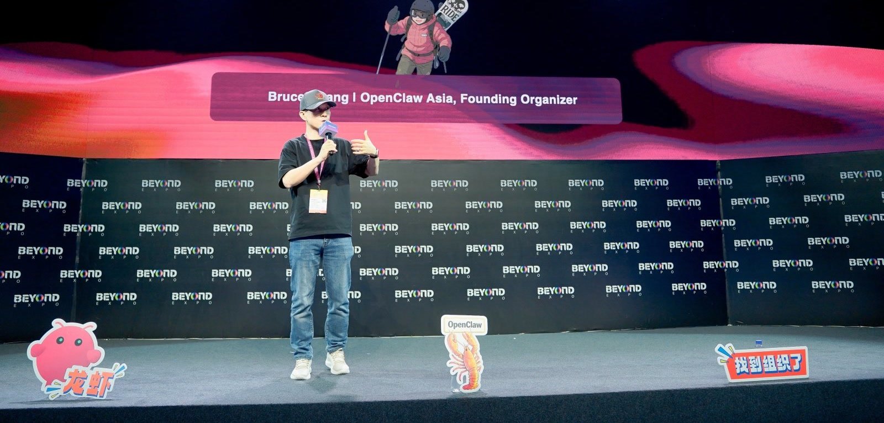
Product & Community
產品與社區
ClawCon HK
February · 2 月
HolyCrab / AI video generation
ClawCon Macao
@ The Venetian Macao
Late May · 5 月底
Notes:
Suggested time 0:45
Visual: Product & Community — ClawCon HK in February, ClawCon Macao in late May, HolyCrab video generation
My background includes Microsoft and Alibaba Cloud. I now work on two connected things. I founded OpenClaw Asia, an independent regional community for people building and using agents. I also founded HolyCrab.ai, an AI model and API aggregation platform, currently focused on AI video. On the left, the upper photo is ClawCon HK in February; the lower photo shows my opening remarks at ClawCon Macao at The Venetian Macao in late May. On the right is the public HolyCrab website’s visual video generator preview: prompt input, reference media and video settings. This is a public product showcase screenshot, not a signed-in task or a generated result. People arrived with very different questions. Developers wanted more reliable systems. People in business wanted help with real tasks. The community shows me how people get started. HolyCrab shows me what it takes to turn a task into a deliverable. That is the perspective I am bringing today.
中文提示
我是 Bruce Huang。之前在微軟、阿里雲做過平台相關工作，之後進入創業。現在我做兩件相互連接的事：OpenClaw Asia，是我發起的獨立區域社區；HolyCrab.ai，是我們做的 AI 模型與 API 聚合平台，目前聚焦 AI 視頻。
左上是 2 月的 ClawCon HK，左下是 5 月底在澳門威尼斯人舉行的 ClawCon Macao。右側是 HolyCrab 官網公開展示的影片生成介面，包含提示詞、參考素材和影片設定；這是產品展示截圖，不是登入後的任務紀錄或生成結果。線下最有意思的地方，是每個人帶來的問題都不一樣：開發者想讓系統更穩定，做業務的人想把手頭的事交出去。
我在社區看到大家怎樣開始用 Agent，在 HolyCrab 看到一次任務怎樣變成實際交付。今天我會把這兩邊的觀察連起來。
過渡：先看美國這邊，產品正在接住什麼工作。
Sources
https://brucehuang.ai/talks/polyu-ai-phd-guest-lecture-2026-09/
https://brucehuang.ai/
https://x.com/OpenClaw_ASIA/status/2060935146295984377

Slide 6
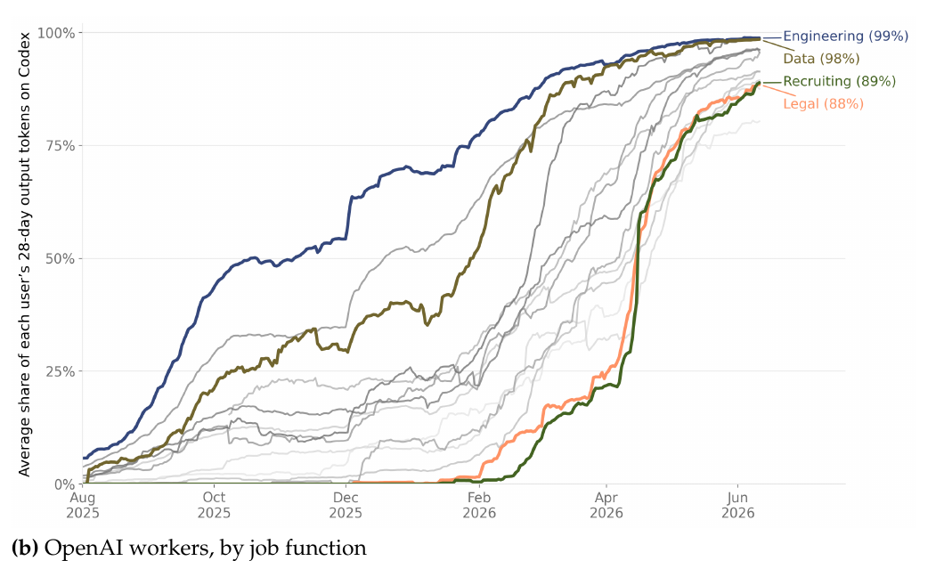
01 / TOP AI TRENDS / WORK PRODUCTS
Codex use across functions at OpenAI
OpenAI 內部不同職能的 Codex 使用份額
AI is moving
into real work
模型能力正在進入工作流
Codex for project execution
Codex 接住開發與項目任務
Claude Code and Cowork
Claude 接住代碼與知識工作
Look at the work a product can take on
看產品能接住什麼任務
OpenAI, June 2026 / Internal employees / Share of output tokens
6 / 27
Notes:
Suggested time 1:00
Visual: Codex use across functions at OpenAI
One important trend is that model capability is becoming a work product. OpenAI puts it into Codex. Anthropic brings it into Claude Code and Cowork. The question is what work the product can take on. This chart shows Codex use inside OpenAI, across different job functions. Notice how use expands beyond engineering. The measure is the share of output tokens, not a percentage improvement in productivity. It is also an internal sample. I use it to show a direction: AI is becoming part of the environment where people do their work. Files, tools and delivery now matter alongside the model itself.
中文提示
一個重要趨勢，是模型能力正在進入工作產品。OpenAI 的 Codex，以及 Anthropic 的 Claude Code 和 Cowork，開始接住代碼庫、文件夾和知識工作。左圖是 OpenAI 內部不同職能的使用情況，縱軸是輸出 token 份額，不能讀成效率提升幅度。我們看的是工具怎樣進入工作環境。
Sources
https://openai.com/index/how-agents-are-transforming-work/
https://openai.com/codex/
https://claude.com/product/claude-code
https://claude.com/product/cowork

Slide 7
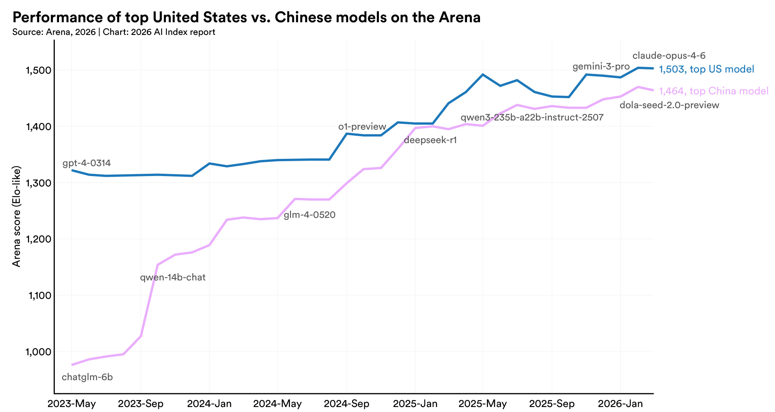
01 / TOP AI TRENDS / MODEL CAPABILITY
Leading models on Arena
Stanford AI Index：頭部模型表現
More models
are near
the frontier
更多模型正在接近能力前沿
Watch the gap between the curves
先看曲線之間的距離
Then ask what the product can deliver
再看產品能否完成工作
Arena data through March 2026
歷史趨勢背景，不是即時榜單
Stanford AI Index 2026 / Arena data through March 2026
7 / 27
Notes:
Suggested time 0:45
Visual: Leading models on Arena
Here is another trend: more models are approaching the frontier. This chart compares leading US and Chinese models on Arena. You do not need to remember the scores. Look at how the distance between the curves changes. The gap on this evaluation has narrowed. But a benchmark score does not tell us whether a product will finish our report or handle a messy folder. The model is one part of the system. Tools, context and checks still matter. These data run through March, so treat the chart as background, not a live ranking. Next, let us look at the products people can actually open.
中文提示
這張圖比較美國和中國頭部模型在 Arena 上的表現。先看曲線距離的變化，不用記分數。差距收窄是一個趨勢背景，但評測分數不能直接回答產品能否交出報告、處理複雜文件。數據截至三月，不是九月即時排名。
Sources
https://hai.stanford.edu/ai-index/2026-ai-index-report/technical-performance

Slide 8
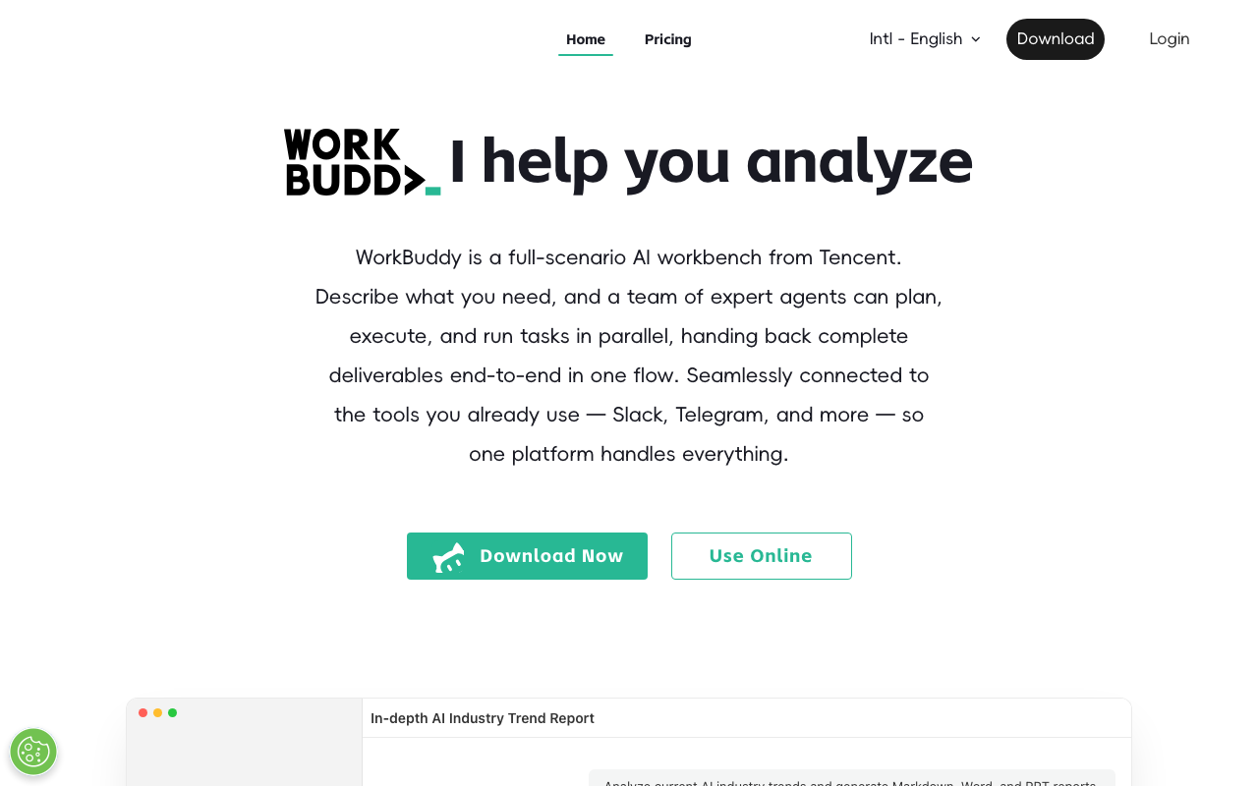
01 / TOP AI TRENDS / DESKTOP TOOLS
WorkBuddy: a workspace for tasks
WorkBuddy 官方工作台與任務入口
AI is coming
to the desktop
WorkBuddy、豆包，把 AI帶進桌面。
WorkBuddy works with local files
WorkBuddy 處理本地文件和辦公成果
Doubao reads files and pages
豆包輔助理解文件與頁面
Available actions depend on the product
實際入口與權限決定執行深度
Tencent WorkBuddy / Official website capture, September 12, 2026
8 / 27
Notes:
Suggested time 0:45
Visual: WorkBuddy: a workspace for tasks
WorkBuddy and Doubao illustrate another useful change: AI is getting closer to the desktop and the materials people already use. WorkBuddy presents itself as a workspace that can work with local files and produce documents, spreadsheets and presentations. Doubao's desktop app helps people read files, understand pages and search for information. The depth of execution differs. Understanding a page does not automatically mean completing an entire process across every app. Start with a task you know well, then check which actions your product actually supports. You do not need to memorize a product ranking before you begin.
中文提示
在中國這一側，工作入口是一個值得看的角度。WorkBuddy 的官方定位就是職場工作台，可以操作本地文件、形成文檔、表格和演示稿。豆包桌面版強調共享軟件內容、讀網頁、看文檔、搜索和解釋。
這些能力的執行深度不同。能看懂當前頁面，並不自動意味着能在所有軟件裏完成整段任務。我們要看自己使用的那個入口，實際開放了哪些動作。
所以我不會讓大家先背產品榜單。先找到一件常做的工作，再看哪個入口能接住它。
過渡：到底怎樣的行為，我們在這場分享裏叫 Agent？
Sources
https://www.workbuddy.ai/
https://www.codebuddy.cn/docs/workbuddy/Quickstart
https://www.doubao.com/download/desktop

Slide 9
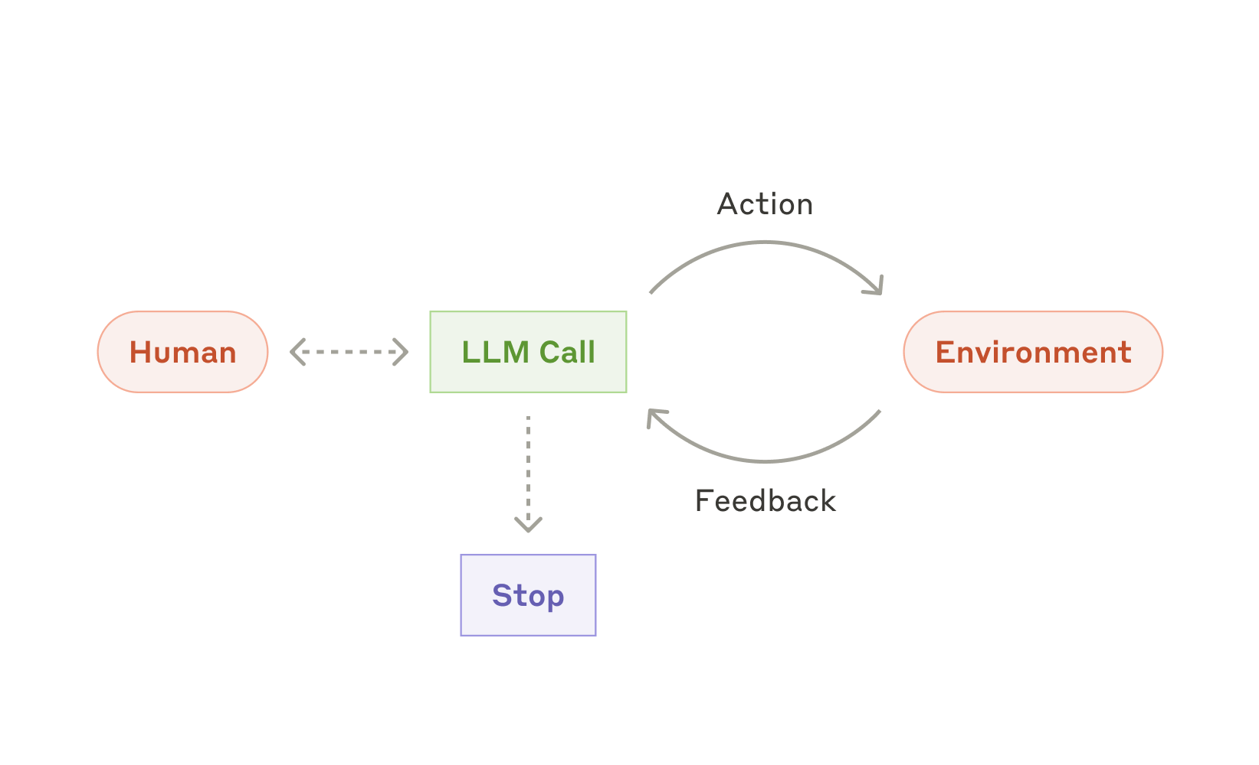
02 / HOW AN AGENT WORKS
The action and feedback loop
Anthropic · Agent 的行動、反饋與停止循環
An agent acts
and learns from
the result
Agent 帶着目標行動，再根據反饋調整
It uses tools to make progress
使用工具推進工作
Feedback shapes the next step
根據結果決定下一步
The harness gives it a place to work
Harness 是配套的執行環境
Anthropic / Building effective agents / December 19, 2024
9 / 27
Notes:
Suggested time 1:00
Visual: The action and feedback loop
This is the basic loop. A person gives a goal. The model chooses an action, and a tool applies that action in an environment. The result comes back. The agent then decides whether to continue, change its approach or ask for help. Imagine asking for a customer presentation. It needs to read the brief, notice missing information, make a draft and check the file. Each result changes what it should do next. A harness is the working environment around this loop: the tools, files, saved progress and operating limits. Here, learning from a result means adjusting the next action. It does not necessarily mean retraining the model.
中文提示
看這張最簡單的循環圖。人交一個目標，模型選擇動作，工具把動作落到環境裏。環境把結果交回來，Agent 再決定繼續、修改，還是停下來找人。
比如“替我做一份客户演示”：它要讀 brief，檢查缺少什麼，寫分鏡，生成文件，再核對要求。每一步看到的結果，會影響下一步。
Harness 這個詞可以理解成配套的工作環境：有哪些工具，材料放哪裏，進度怎麼保存，能做什麼，出錯怎麼辦。這個循環接起來，才有持續做事的可能。
過渡：用這張圖看產品，名字就容易記住了。
Sources
https://www.anthropic.com/engineering/building-effective-agents

Slide 10















TOP AI TRENDS / THE AGENT LANDSCAPE
Choose by the work you need done
按工作入口選擇；產品能力會重疊
Agents now span
Build software
Finish office work
編程與項目執行
辦公文件與跨應用任務
more of our work
Agent 正在覆蓋更多種工作
Codex
Claude Code
Cursor
Claude Cowork
WorkBuddy
Grok Build
GitHub Copilot
Qoder
Doubao Work
QwenWork
Complete an assignment
Keep a teammate
From coding to office tasks
從目標到完整交付
記住背景，持續協作
從編程走向辦公任務
From one task to ongoing work
Manus
ChatGPT
從一次交付走向持續協作
Work
Grok Bot
OpenClaw
Hermes
Genspark
Perplexity
Super Agent
Computer
Memory · routines · handoffs
Choose by task. The categories overlap.
先選工作，再選入口；各類能力正在融合。
Bruce Huang / Task-based map from official product pages / Checked September 13, 2026
10 / 27
Notes:
Suggested time 1:30
Visual: Four entry points into agent work
Here is the landscape on one page. Read it by the work you want to hand over. For software, there are Codex, Claude Code, Cursor, Grok Build, GitHub Copilot and Qoder. Coding agents also work with files, research and other project tasks. For office work, look at Claude Cowork, Tencent WorkBuddy, Doubao Work and Alibaba's QwenWork, or 千問辦公. Alibaba has brought together capabilities from QoderWork, Mulerun and Wukong. For a complete assignment, look at Manus, ChatGPT Work, Genspark Super Agent and Perplexity Computer. These products can research, use tools and create finished deliverables. ChatGPT Work is the current product name; OpenAI’s help center says the earlier ChatGPT agent experience is no longer available. For an ongoing teammate, look at Grok Bot, OpenClaw and Hermes. Grok Bot keeps working on a persistent cloud computer. It is a different product from Grok Build, the coding agent. These areas overlap. My takeaway is that agents are becoming environments where work happens. Choose a useful task and an output you can judge, then choose the tool. We will look more closely at a few of these next.
中文提示
這頁按工作入口看，不按國家，也不按能力高低。編程類包括 Codex、Claude Code、Cursor、Grok Build、GitHub Copilot 和 Qoder；辦公類包括 Claude Cowork、騰訊 WorkBuddy、豆包工作和阿里千問辦公 QwenWork。千問辦公整合了 QoderWork、Mulerun 與悟空的核心能力。完整交付類包括 Manus、ChatGPT Work、Genspark Super Agent 和 Perplexity Computer，例如從調研到報告、簡報或原型。OpenAI 的最新官方資料已以 ChatGPT Work 承接長程多步任務，這裏使用目前名稱。Grok Bot、OpenClaw、Hermes 則可以從持續協作的助手來理解。Grok Bot 有持續運行的雲電腦，Grok Build 是另一款編程 Agent。各區會重疊：編程 Agent 能處理辦公工作，辦公平台也能做網站。圖表達的是常見入口，不是產品能力上限。先明確任務與可檢查的結果，再選擇工具。豆包工作的依據是 9 月 10 日公佈、9 月 17 日生效的最新政策，不代表現場每個人都已有相同入口；實際開放範圍取決於版本與地區。
Sources
https://openai.com/codex/
https://openai.com/index/introducing-the-codex-app/
https://code.claude.com/docs/en/overview
https://claude.com/product/cowork
https://cursor.com/docs/agent/overview
https://docs.x.ai/build/overview
https://docs.github.com/en/copilot/concepts/agents/cloud-agent/about-cloud-agent
https://docs.qoder.com/desktop/overview
https://cloud.tencent.com.cn/product/workbuddy
https://www.doubao.com/legal/privacy
https://ali-home.alibaba.com/document-2021039099929952256
https://manus.im/solutions/product
https://docs.x.ai/grok-bot/overview
https://openclaw.ai/
https://hermes-agent.nousresearch.com/
Logos identify products, not a ranking. WorkBuddy, Cowork and coding agents can also complete entire assignments; the map shows common starting points, not exclusive capabilities.
Logo 用於辨識產品，並非排名。WorkBuddy、Cowork 和編程 Agent 也能完整交付任務，分區只代表常見入口。
https://help.openai.com/en/articles/20001275-chatgpt-work-and-codex
https://www.genspark.ai/helpcenter/super-agent
https://www.perplexity.ai/products/computer

Slide 11
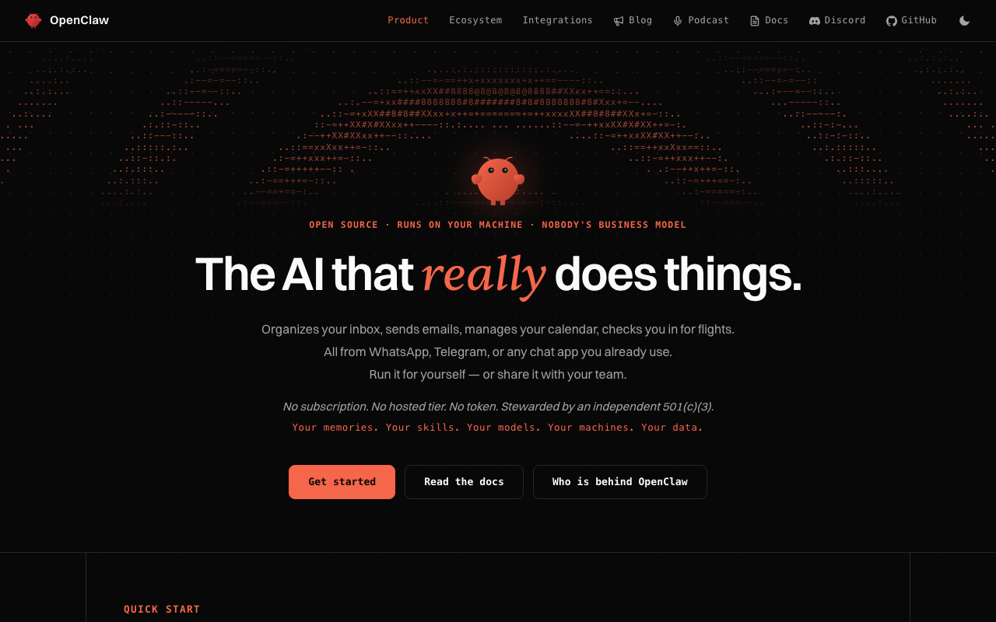
02 / OPENCLAW
OpenClaw: an open personal assistant
OpenClaw 官方主頁 · 開源個人助手
OpenClaw
gives recurring
work a home
OpenClaw：把持續任務，放進日常入口。
A familiar messaging entry point
從熟悉的消息入口開始
Try one daily briefing
先試一份每天要看的簡報
Start with one recurring task
先接一件事，再擴大可用工具
OpenClaw / Official website capture, September 12, 2026
11 / 27
Notes:
Suggested time 1:00
Visual: OpenClaw: an open personal assistant
OpenClaw is useful to think about as a home for recurring work. You can reach an assistant through a familiar messaging entry point, while it has a workspace and tools behind it. A good first task is a daily briefing from a small set of public sources. Specify the sources, the output and when it should ask you a question. Start with drafts you can review. Once one task works reliably, you can decide which additional tools it needs. The important part is the recurring task and its boundaries, not connecting everything on day one.
中文提示
OpenClaw 的直觀特點，是把助手帶到你已有的消息入口，並連接自己的工作空間和工具。你不必每次重新解釋所有背景，才開始處理一件重複發生的事。
比如做 HolyCrab 的產品資料簡報，可以先讓它按你選定的公開來源，整理變更、保留鏈接、單列不確定項。第一步只做到生成草稿，連續幾次核對之後，再考慮定時運行。
這類長期助手的價值，不在於裝了多少插件，而在於它能不能持續接住一件有用的工作。
過渡：任務重複發生後，下一次能不能做得更好？
Sources
https://openclaw.ai/

Slide 12

02 / HERMES
Hermes Agent: memory and Skills
Hermes Agent 官方主頁 · 持續記憶與 Skills
Hermes can
carry experience
into the next task
Hermes：把這次經驗，留給下次用。
Persistent memory and reusable Skills
持續記憶與可複用 Skills
Turn a correction into a rule
把一次修正寫成下一次的規則
Saved experience still needs checking
記住流程，仍要核對結果
Nous Research / Capture September 2 / Positioning checked September 12, 2026
12 / 27
Notes:
Suggested time 1:00
Visual: Hermes Agent: memory and Skills
Hermes highlights a different part of the long-term assistant story: carrying experience from one task into the next. It combines persistent memory with reusable Skills. Suppose a draft repeatedly gets a product name wrong. The useful next step is to save the correction as a clear rule and check that the next task follows it. That is more valuable than repeating the same instruction every time. This does not mean the base model has retrained itself, or that saved memory is always correct. You still need to review results. The goal is to make useful experience easier to reuse.
中文提示
Hermes 強調持續記憶和自動形成 Skills。你可以把 Skill 想成可複用的做法：輸入是什麼、先做什麼、怎麼檢查。
還是那份資料簡報。如果上次漏了發佈日期，我們就把“每條信息保留來源日期”寫進規則；如果摘要混進了推測，就補上事實與判斷的分列要求。下一次任務可以複用這些經驗。
這裏主要講的是客户端的記憶和工作方法，不能把它直接説成底層模型被重新訓練了。保存下來的方法，也需要用新任務檢查。
過渡：如果開發者想連整個工作環境都自己組裝呢？
Sources
https://hermes-agent.nousresearch.com/

Slide 13
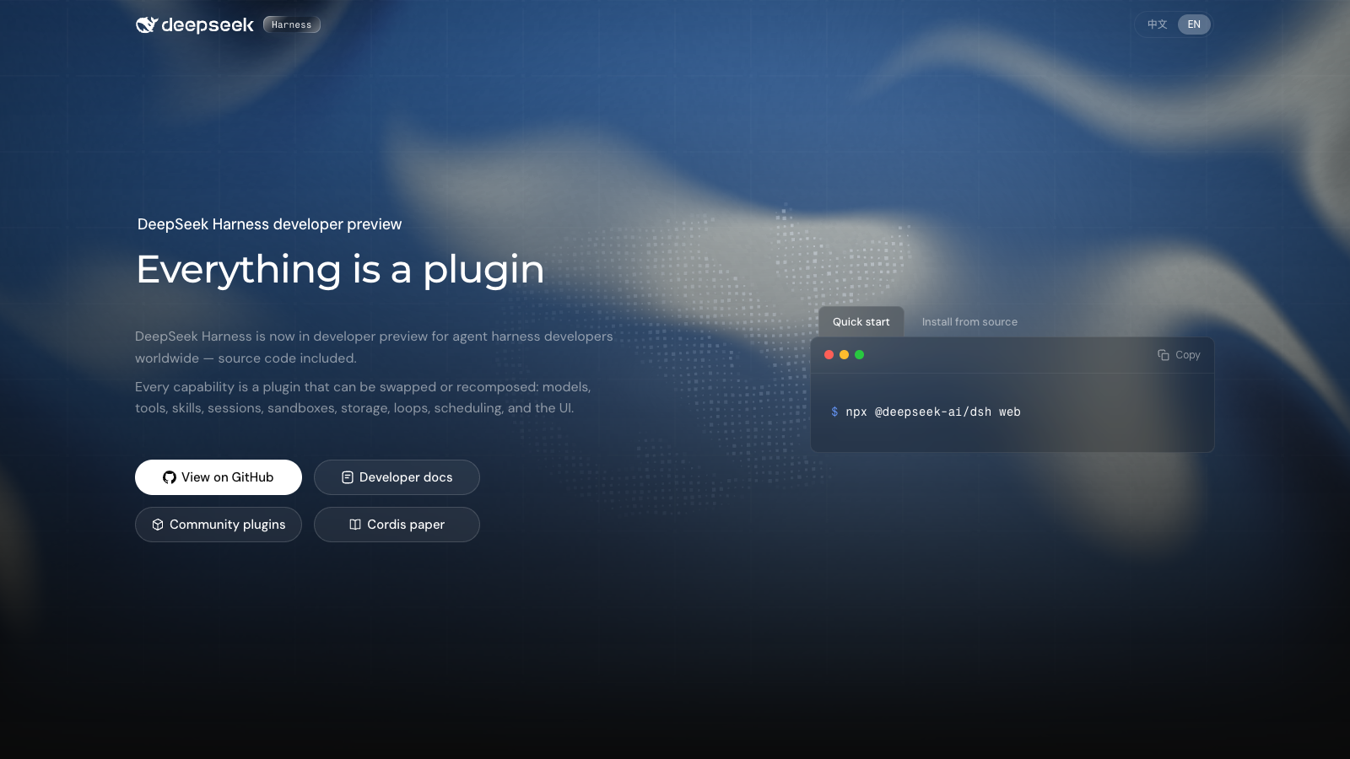
02 / DEEPSEEK HARNESS
DeepSeek Harness: everything is a plugin
DeepSeek Harness 官方主頁 · Everything is a plugin
DeepSeek Harness
lets developers
assemble agents
DeepSeekHarness：讓能力可組裝。
Tools, sessions and execution loops
工具、會話與執行循環
Capabilities connect as plugins
按需要組合插件能力
Developer preview: use a sample project
開發者預覽，適合隔離的試驗項目
DeepSeek / Capture September 2 / Positioning checked September 12, 2026
13 / 27
Notes:
Suggested time 0:45
Visual: DeepSeek Harness: everything is a plugin
DeepSeek Harness is about the environment around the model. Its organizing idea is that capabilities can be composed as plugins. Developers can work with models, tools, sessions and execution loops as parts of a system. This matters when a ready-made application does not fit the task you want to build. It also helps explain why a harness is different from a model. The model contributes intelligence; the surrounding system makes actions possible and keeps work organized. The official product is still a developer preview. For a first experiment, use an isolated folder with sample files and a clearly defined task.
中文提示
DeepSeek Harness 把可組裝這件事擺到了台前。模型、工具、會話、沙箱、執行循環和界面，都通過插件組織。
對開發者來説，可以在這裏研究：換一種工具、保留不同的任務狀態，或者增加一次檢查，是否讓系統更適合某項工作。它屬於執行環境這一層，不等同於 DeepSeek 模型本身。
它仍處於開發者預覽。第一次實踐，我建議用一個獨立的樣例目錄，先讓它讀文件、解釋計劃，再放開有限的寫入。技術細節不需要今天全記住。
過渡：如果你現在只想交一個項目，現成產品可以從哪裏開始？
Sources
https://deepseek.com/harness/en/

Slide 14
02 / CODEX AND CLAUDE
Sample CSV to a review list
從樣例記錄到待複審鏡頭
Codex and Claude
can return
Request
Find failed shots and explain why
篩出未通過的鏡頭與原因
finished work
需求
把需求交出去，帶回可檢查的成果
Execute
Read, filter and write the result
執行
讀文件，完成篩選並寫出結果
Code and files become deliverables
項目執行可以交回文件與工具
Check
Verify a few known records
A clear check defines completion
檢查
用已知記錄逐項核對
先寫清怎樣知道任務完成
Ask for an output you can open and check
把“做完了”寫成可觀察的行為
Bruce Huang / Fictional project exercise, not a product benchmark
14 / 27
Notes:
Suggested time 1:15
Visual: A sample CSV becomes a review list
A simple way to try Codex or Claude is to ask for a small deliverable from a folder. In our example, you give it a CSV of candidate video shots and ask it to identify the ones that need another review. Codex and Claude Code can help with project execution and code. Claude Cowork offers an entry point for files and knowledge work. The key is the same: say what you want back and how you will check it. Ask for a review CSV, then compare a few known records with the source. An agent saying it is done is less useful than a file you can open and verify.
中文提示
假設 HolyCrab 團隊需要一個小工具：整理樣片評審結果，找出還沒通過的鏡頭。我們可以把樣例 CSV 和字段解釋交給 Codex 或 Claude Code，讓它實現篩選，並用幾條已知記錄驗證。
如果主要成果是整理文件、分析材料、製作知識工作交付物，也可以從 Claude Cowork 的對應入口開始。產品名稱很接近，關鍵仍然是當前入口能訪問什麼材料、執行什麼動作。
一個更好的任務是：“輸出待複審列表，列出原因；用我給的三條記錄驗算。”你交出的就包括了做法和結束條件。
過渡：在這樣的工作方式裏，人會分成哪些角色？
Sources
https://openai.com/codex/
https://claude.com/product/claude-code
https://claude.com/product/cowork

Slide 15
03 / THE FUTURE OF WHITE-COLLAR WORK
01
AI Foundation
White-collar work
研究模型與訓練
Models and new capabilities
now has only
three categories
02
Agent Builders
白領工作，只剩三類
搭建能執行的系統
Tools, execution and recovery
Research the models
03
AI in Business
研究模型
Build agents or apply AI in business
把 AI 用進業務
搭建 Agent，或把 AI 用進業務
Useful outcomes in a real context
Which kind of work will you own?
你要負責哪一類工作？
Bruce Huang / A framework for discussing roles in AI
15 / 27
Notes:
Suggested time 1:15
Here is my provocation: white-collar work now has only three categories. This is my way of looking at how work is changing, not a literal census of every occupation. First, improve AI itself: foundation research, models and training. Second, build agents that can perform work: tools, execution and recovery. Third, use AI to deliver business outcomes: understand the customer, define the task and judge the result. Most people in this room will find their largest opportunity in the third category. These kinds of work overlap, and a person may do more than one. The practical question is: which kind of work will you own, and what will you deliver with AI?
中文提示
我今天想提出一個判斷：白領工作，只剩三類。這是我理解工作變化的框架，不是説統計上所有職業已經消失，只剩三種職稱。第一類，研究 AI 本身，做模型、訓練和基礎能力。第二類，搭建 Agent，讓它能調用工具、執行任務、處理錯誤。第三類，用 AI 做業務，理解客户、定義任務、判斷結果，交付真正有用的成果。對在座大多數人來説，第三類是最直接的機會。三類工作會交叉，一個人也可以兼做幾類。你要選的，是你準備負責哪一類工作，以及用 AI 交付什麼成果。
過渡：三類工作的作品，分別要回答什麼問題？

Slide 16
03 / WHAT EACH ROLE OWNS
01
Research
Your value
研究模型
A question and a reproducible experiment
comes from the
問題、實驗與可復現結果
problem you solve
02
Build agents
你的價值，體現在你能解決哪種問題。
搭建 Agent
Execution that recovers and checks
執行、恢復與驗證
Research proves a capability
03
Apply AI
研究要證明新能力
Builders and users make it useful
業務應用
開發與業務把能力變成結果
A useful outcome you can judge
業務目標、判斷與成果
Choose the responsibility you want to own
從職責出發，決定下一步練什麼
Bruce Huang / Career practice framework
16 / 27
Notes:
Suggested time 1:00
Visual: Different roles need different evidence
Each role needs different evidence. A researcher needs a clear question, an experiment and a result other people can reproduce. An agent builder needs to show execution, recovery and verification. Someone applying AI in business needs to define the outcome and judge whether the work is useful. Knowing lots of tool names is not enough by itself. Your value becomes clearer when you can point to a problem you solved and explain the decisions you made. That also makes learning more concrete. Start with the responsibility you want to take on, and practice the skills that responsibility requires. Keep the opening question in mind: which part of this result needs our judgment, even when the steps become easier to execute?
中文提示
做 Foundation 研究，要説明你解決了什麼問題，實驗如何驗證，別人能不能復現。做 Agent，要説明它在什麼環境裏能完成任務，失敗後怎麼辦，怎樣檢查結果。做業務應用，要説明原來的工作怎樣做，現在的結果是否更好，哪裏仍然需要人的判斷。
這些證據，比“我會用很多 AI 工具”更具體。今天的現場，大多數人可以從一個已有業務任務開始，不需要先變成模型研究者。
過渡：我們用一個完整的 HolyCrab 場景，把業務任務展開。
Sources

Slide 17
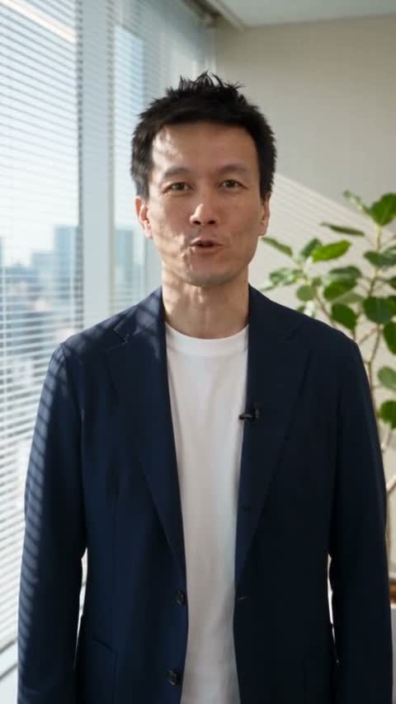
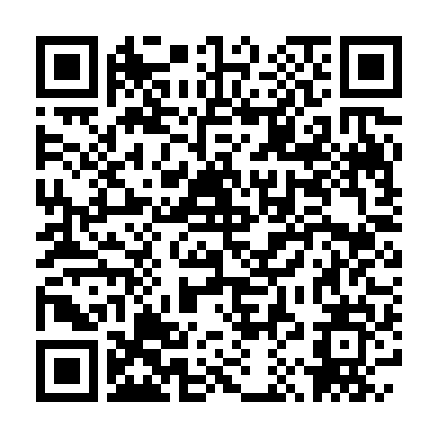
04 / HOLYCRAB / A REAL BD CASE
A real introduction.
In Japanese.
用日語，做真實的商務自我介紹
Used in client meetings in Japan
在日本客戶會面中使用的自我介紹
Start with one real conversation.
從一個真實的溝通任務開始
Bruce Huang / HolyCrab · Japanese BD introduction · 34 seconds
17 / 27
Notes:
Suggested time 1:10, including the 34-second video. This is my Japanese self-introduction, used when meeting clients in Japan. This first example serves a real BD conversation. Play the film. The practical lesson: choose one specific audience and one real communication task. Prepare an approved introduction, check the Japanese with someone fluent, then review the finished video before using it. Use your own authorized likeness. This finished video does not establish which model, voice process or number of generations produced it, and no sales outcome is claimed. Next, I will show the iPhone Duo advertisement we made for this afternoon’s workshop.
中文提示
這是我去日本見客戶時使用的日語自我介紹。先看一個服務真實 BD 場景的例子。先播放 34 秒影片，再講實操：選定一位受眾、一個具體溝通任務，先確認自介內容，找懂日語的人校對，最後檢查成片再使用。使用本人已授權的形象。不從成片反推模型、聲音處理或生成次數，也不宣稱成交結果。下一頁看我們為下午工作坊製作的 iPhone Duo 廣告。
Source: Bruce-provided Japanese client introduction; workshop slide 9. Duration 34.125 seconds; 480 × 854.

Slide 18
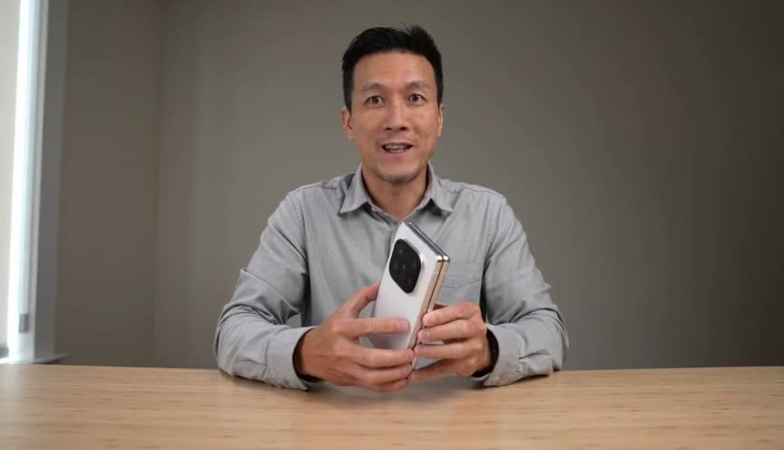
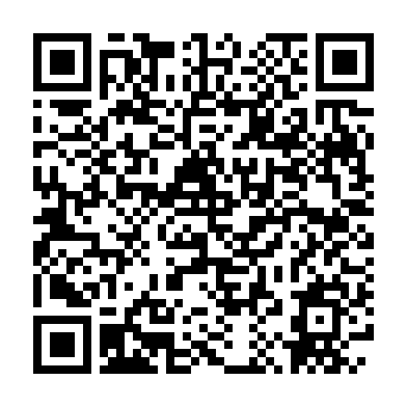
04 / HOLYCRAB / AN ACTUAL WORKSHOP RESULT
iPhone Duo / AI concept advertisement
Two clips. One
30-second ad.
兩段影片，合成一支 30 秒廣告
Made with HolyCrab
Seedance 2.0 Fast · 2 tasks
同一人物、產品與銜接末幀
See the workflow
下午一起實作
Review the product and the join.
AI concept demo · Not an official Apple advertisement / AI 概念示範，非 Apple 官方廣告
18 / 27
Notes:
Suggested time 1:30, including the 30-second video.
This is an actual result from our latest AI Ultra Festival AI Video Workshop, using my authorized reference photos and a product reference. We made an iPhone Duo concept advertisement through HolyCrab. Two Seedance 2.0 Fast tasks produced the two clips; the actual final frame of the first clip was reused to begin the second. A local edit joined them into a 30.336-second film with English audio. The two generation tasks used 85 credits each. This is a workshop output, not a client campaign or an official Apple advertisement. Watch the result first. Then inspect the phone geometry and the join: the generated phone has visible inaccuracies, and the second clip crops the product during the push-in. A finished file is not the same thing as a production-approved ad. The person still defines the brief, checks the product and decides what can be released. This afternoon we will walk through the workflow. Next, let us look at how the agent connects these steps.
中文提示
這是最新版 AI Ultra Festival AI Video Workshop 已經做出的成果：用我授權的人物照片和產品參考圖，經 HolyCrab 做 iPhone Duo 概念廣告。兩次 Seedance 2.0 Fast 任務各產出一段，再把 A 的實際末幀交給 B，最後本地剪接成約 30 秒、保留英文聲音的影片。兩次生成各 85 credits。這是真實工作坊產物，並非客户投放案例，也不是 Apple 官方廣告。先看片，再看問題：手機結構仍有錯誤，後段推近時產品被裁切，銜接也要檢查。交出一個檔案，不代表已經達到正式發布標準。人仍然要定方向、檢查產品、決定能否交付。下午會一起做這套流程。
Source: Latest Vibe-Filming-24-Actual-Inputs.pptx, slide 16, September 13, 2026.
https://brucehuang.ai/talks/ai-ultra-video-workshop-2026-09/cli-review/#16

Slide 19
04 / HOLYCRAB / THE WORKFLOW
A workflow with a review loop
一條可以檢查、修正的製作流程
Agents move
the work forward.
Read
Plan shots
Generate
Review
Deliver
People judge it.
→
→
→
→
讀材料
寫分鏡
生成
核對
交付
讓 Agent 推進流程，讓人判斷成片
A failed shot goes back with a reason
發現問題，回到對應鏡頭修改
Review each shot against the brief
逐鏡頭對照要求核驗
People approve direction, spending and release
Return problems to the right step
方向、預算與最終成片由人確認
發現問題，回到對應環節修改
Keep task IDs, inputs and review reasons
保留任務編號、輸入參數與評審原因
People approve direction, spending and release
方向、預算與最終成片由人確認
Bruce Huang / Fictional teaching workflow, not a measured customer result
19 / 27
Notes:
Suggested time 1:30
Visual: One workflow with a review loop
Now we can connect the work. Read the brief, draft the shots, generate candidates, check them and prepare the handoff. The important connection is the feedback loop. If one shot fails, the result should go back to that shot with a reason for the revision. Keep the task ID, the input parameters and the review reason. People still approve the direction, spending and final release. HolyCrab is the context for this example because our work involves model and API choices for AI video. The lesson applies elsewhere: useful automation carries both the work and the information needed to judge it.
中文提示
看左邊這條鏈。Agent 先讀 brief，形成分鏡和缺失材料清單。人確認方向後，再調用已經配置的模型工具生成候選素材，記錄參數和對應鏡頭。接着做規格檢查，整理評審清單。
比如第三個鏡頭的產品外觀不一致，我們要能定位是哪一條任務、用了什麼輸入，然後只改這一段。並不是整份項目從頭重來。
人的價值在於定方向、審美判斷、確認品牌表達，以及最後決定哪條能交。Agent 的價值是把需要反覆推進和核對的步驟接起來。這個案例沒有省時百分比，因為這裏沒有做那樣的實測。
過渡：流程越完整，Agent 可以持續工作的時間也越長。
Sources

Slide 20
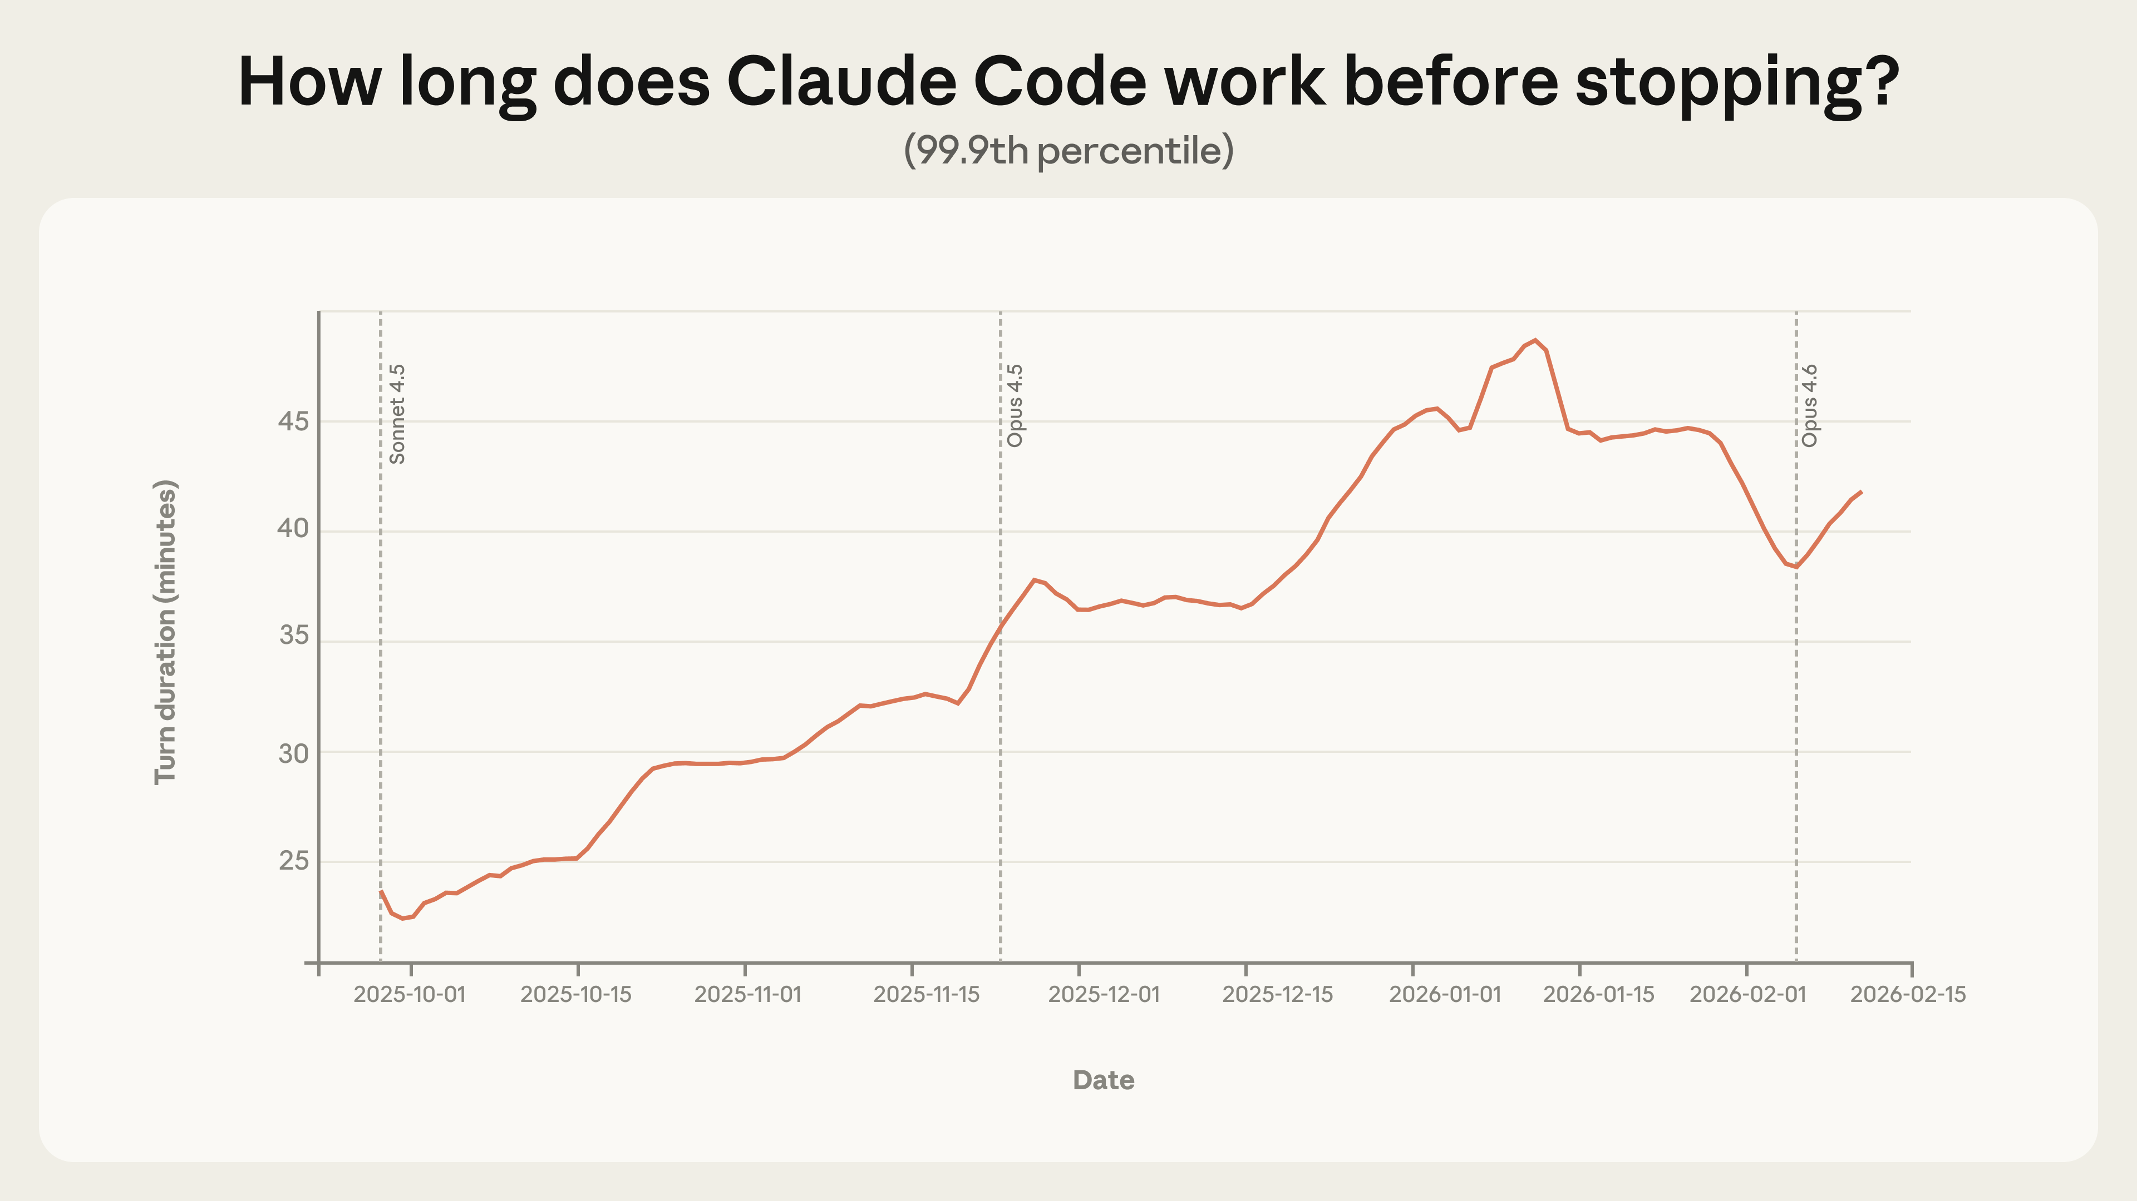
04 / AUTONOMY / WHAT THE DATA SHOWS
How long Claude Code works before stopping
Claude Code 單次連續執行時長的 99.9 分位數
Long tasks
are getting
longer
長任務，開始能持續更久了。
This is the longest-running tail
圖中展示運行最久的一小部分
Typical tasks are much shorter
日常任務仍然短得多
99.9th percentile; median around 45 seconds
不能把最長尾部當成日常水平
Anthropic / Measuring agent autonomy / February 18, 2026
20 / 27
Notes:
Suggested time 1:00
Visual: How long Claude Code works before stopping
This chart gives us a careful way to talk about longer agent work. It tracks how long Claude Code continues before stopping at the ninety-nine-point-ninth percentile. That means the far end of the distribution: a very small share of long runs. We should not read it as the typical experience. The median in the study was around forty-five seconds. It is also continuous execution time, not the amount of human labor replaced. The useful question is what lets a task keep making progress: clear materials, usable tools, feedback and a way to recognize when to stop.
中文提示
看這張實際測量圖。Anthropic 觀察 Claude Code 的連續執行時長，最右邊很長的那一小部分任務，已經能持續更久。
一定要看清口徑：這條線是九十九點九分位數，日常中位數約四十五秒。它不是説大家每次都可以放手四十五分鐘，也不能直接換算成人類工時。
它對我們的啓發，是開始練習怎樣交辦更完整的任務，同時保留反饋和檢查。
過渡：我給大家一個進階練習目標。
Sources
https://www.anthropic.com/research/measuring-agent-autonomy

Slide 21
04 / PRACTICE / ONE HOUR
An advanced practice goal
一次進階實踐
Could an agent
60
advance an hour
of useful work?
minutes
你能讓 Agent自主推進一小時工作嗎？
分鐘
Give it a clear task and materials
A task with enough context and clear limits
任務清楚，材料夠用
任務清楚、材料夠用、邊界明確
Define checks and stopping points
知道怎樣檢查，也知道何時停下
Act, read feedback and check again
執行、讀反饋，再檢查
Useful progress matters more than runtime
成果質量比運行時長更重要
Bruce Huang / Practice goal, not a universal industry threshold
21 / 27
Notes:
Suggested time 1:00
Visual: An advanced practice goal
Here is a useful challenge as you get more comfortable: can you give an agent an hour of useful work? I do not mean keeping it busy for sixty minutes. I mean handing over a meaningful piece of work with enough context, clear limits and a way to check progress. It might read a set of materials, build an output, test it and revise it. If it finishes earlier with a good result, that is a success. If it runs for an hour without improving the outcome, the clock tells us very little. Start smaller, then extend the task when you understand what works.
中文提示
進階練習是：你能不能交出一項足夠清楚的任務，讓 Agent 在授權範圍內持續推進一小時？重點是有用的工作，不是把計時器跑滿。
例如整理一組公開參考資料、形成分鏡方案、檢查規格、輸出一份問題清單。材料缺了就列出來，需要你做決定就停下來。沒有必要用循環和重複來湊時長。
第一次可以從十分鐘、單一目錄、明確輸出開始。等幾次任務穩定完成，再逐步交更長的一段。
過渡：當一段工作能被交出去，職業會怎樣變化？
Sources

Slide 22
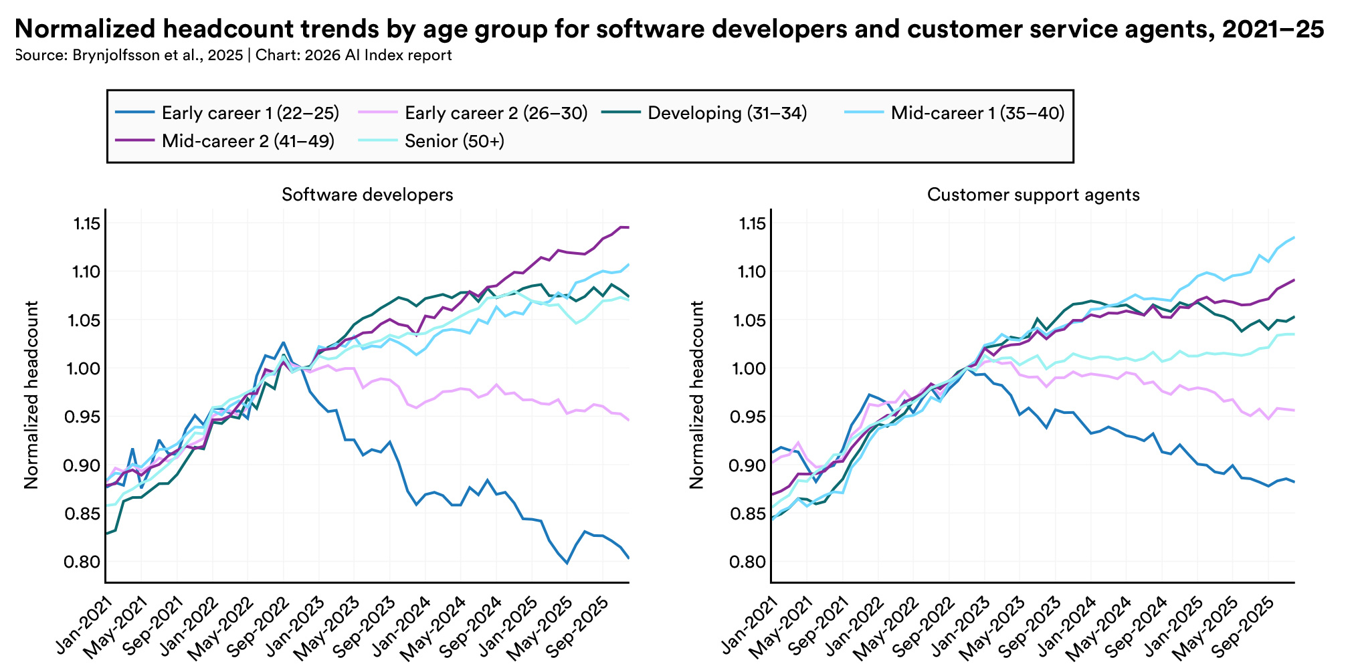
05 / CAREER / UNEVEN CHANGE
Employment trends by age and occupation
Stanford · 按年齡區分的開發與客户支持就業趨勢
Career effects
will be uneven
職業變化，不會平均地落到每個人。
Look at tasks and experience levels
看具體任務與從業階段
Ask which responsibilities are changing
看哪些責任正在改變
This chart alone cannot establish causation
就業觀察不能單獨證明 AI 因果
Stanford AI Index 2026 / US occupational data, 2021–2025
22 / 27
Notes:
Suggested time 1:00
Visual: Employment trends by age and occupation
Career effects will not arrive evenly. This chart separates employment trends by age in software development and customer support in the United States. Look first at the early-career lines, then at how they differ from the other groups. It is an observation about specific occupations and a specific period. The chart alone does not prove that AI caused the pattern. For your own career, the useful move is to examine tasks and responsibilities. Which parts are becoming easier to automate? Which still need someone to define the problem, notice a mistake, make a decision or take responsibility for the result?
中文提示
這張圖把軟件開發和客户支持崗位按年齡拆開。年輕從業者的曲線，與一些更有經驗的羣體並不相同。它提醒我們，變化不會平均落在每個人身上。
這是美國特定崗位的就業觀察，不能只憑這張圖斷言所有變化都由 AI 造成。對個人更有用的問題是：我現在負責哪個步驟，能不能理解前面的目標、接住後面的檢查？
例如開發者把測試和交付接起來，運營把一次整理變成可重複的流程。你承擔的那一段工作，會比工具名單更有説服力。
過渡：現在拿自己的任務做一次練習。
Sources
https://hai.stanford.edu/ai-index/2026-ai-index-report/economy

Slide 23
05 / ACTION / YOUR TASK CARD
Result
What should I receive?
最後要拿到什麼？
A clear result
結果
Materials
needs a
What may it read?
材料
允許讀取哪些材料？
clear check
Actions
What may it do?
先寫清結果，再寫清檢查方法。
操作
允許執行哪些動作？
Checks
How will I judge the output?
Take 45 seconds to write two lines
檢查
怎樣知道結果合格？
現場用四十五秒寫兩句話
Use a task you really need to do
Help
When should it come back to me?
選一件你真的要做的事
求助
什麼情況要交回給人？
What will you receive? How will you check it?
結果是什麼？怎樣知道它合格？
Bruce Huang / Downloadable task card
23 / 27
Notes:
Suggested time 1:45
Visual: Five fields for a useful task
Take out your phone and choose a task you actually need to do. Write just two lines. First: what should I receive at the end? Second: how will I know it is good enough? For example, compare three public sources in a one-page table, with a link for every factual claim and missing information marked clearly. That gives the agent a much better starting point than “do some research.” I will give you forty-five seconds now. [Pause for the full exercise.] Then add the materials, the permitted actions and the situations where it should come back to you. The resources page has a copyable version.
中文提示
請大家現在拿出手機，選一件明天真的要做的事，先寫兩句話：最後我要拿到什麼？怎樣知道它合格？
比如“把這三份公開資料整理成一頁對比表，每條結論附來源；缺失信息留空並標記”。比“幫我研究一下”更容易開始。
現在留四十五秒。〔停頓，讓現場真正動筆。〕
寫好後，再補三件事：材料從哪裏讀、可以執行什麼動作、什麼情況回來問我。你就得到左邊這張完整任務卡。網頁資料區有可複製版本。
過渡：回去以後，第一小時具體怎麼安排？
Sources

Slide 24
05 / ACTION / YOUR FIRST SESSION
0–10 min
One small task
Prepare
One folder and one task card
一個目錄，一張任務卡
is enough
準備
to begin
10–40 min
Run
今晚先完成一個小任務，再保存做法。
Read the materials, then deliver
運行
先讀材料，再交完整輸出
Run it, check it and revise once
40–60 min
運行一次，檢查，再修改一次
Save the useful rule for next time
Review
Revise once and save the rule
把有用的規則保存下來
檢查
修改一次，把做法保存下來
Download the brief, prompts and review rubric
資料頁有完整實操包
Bruce Huang / Suggested timing for a first practice session
24 / 27
Notes:
Suggested time 1:00
Visual: Your first practice session
For your first session, choose one tool you can already use. Make a separate folder and put a few non-sensitive sample files in it. Spend the first ten minutes writing the task card. Ask the agent to read the materials and propose a plan, then produce the output. Keep the last part of the hour for your own review. Open the files, check the facts and look for missing information. Make one correction and save the useful rule. The fictional HolyCrab pack gives you a brief, six candidate records and a rubric. It is a small exercise in giving work, checking it and improving the next attempt.
中文提示
今晚不用把所有工具裝一遍。選你已經能用的一個，建一個獨立目錄，放進幾份非敏感樣例材料。
前十分鐘寫任務卡，接着讓它先讀材料和列計劃，再做一次完整輸出。最後留時間親自檢查：內容對不對，文件能不能打開，缺項有沒有寫出來。把最重要的一次修改，保存成下一次的規則或者 Skill。
我準備了一份 HolyCrab 虛擬練習包：有 brief、樣例評審記錄和驗收表。業務人員可以整理待修改鏡頭，開發者可以寫一個篩選小工具，想研究 Agent 的人可以比較它是否正確處理缺失信息。
過渡：最後，怎樣把這件事變成你的職業證明？
Sources

Slide 25
05 / CAREER / SHOW YOUR WORK
01
Research contribution
Our role is to
研究貢獻
A question and reproducible evidence
set direction and
judge the result
02
A working agent
人的主動權，來自決定方向與判斷結果
可用 Agent
Execution, recovery and checks
Use AI to take on a useful piece of work
03
A business result
用 AI 承擔一件完整、有用的工作
Show the result and the decisions you
業務成果
made
An output, decisions and cost records
展示成果，也展示自己的判斷
brucehuang.ai / Slides and practice materials
演講與練習資料已開放下載
Bruce Huang / OpenClaw Asia / HolyCrab.ai
25 / 27
Notes:
Suggested time 1:10
Visual: Evidence for each kind of contribution
So, when AI can do the work, what will we do? My answer is that we should learn to set direction, organize the work and judge the result. Researchers can show a question and reproducible evidence. Agent builders can show execution, recovery and checks. People applying AI can show a useful outcome and explain their decisions. Learning a tool does not settle every question about jobs or how the benefits are shared. It gives us a concrete place to begin. Return to the person on the lobster: holding the reins means making choices and taking responsibility. Leave today with one useful task you want to try.
中文提示
回到今天的題目：當 AI 開始接手工作，人該做什麼？我的答案是，學會決定方向、組織工作、判斷結果。研究者拿出可復現的證據，開發者拿出可運行且可檢查的系統，業務應用者拿出有用的成果與決策過程。學會一個工具並不能回答就業和收益分配的所有問題，但它給我們一個具體起點。握住繮繩，意味着做選擇、負責任。帶着一件值得嘗試的工作離場。
Sources

Slide 26
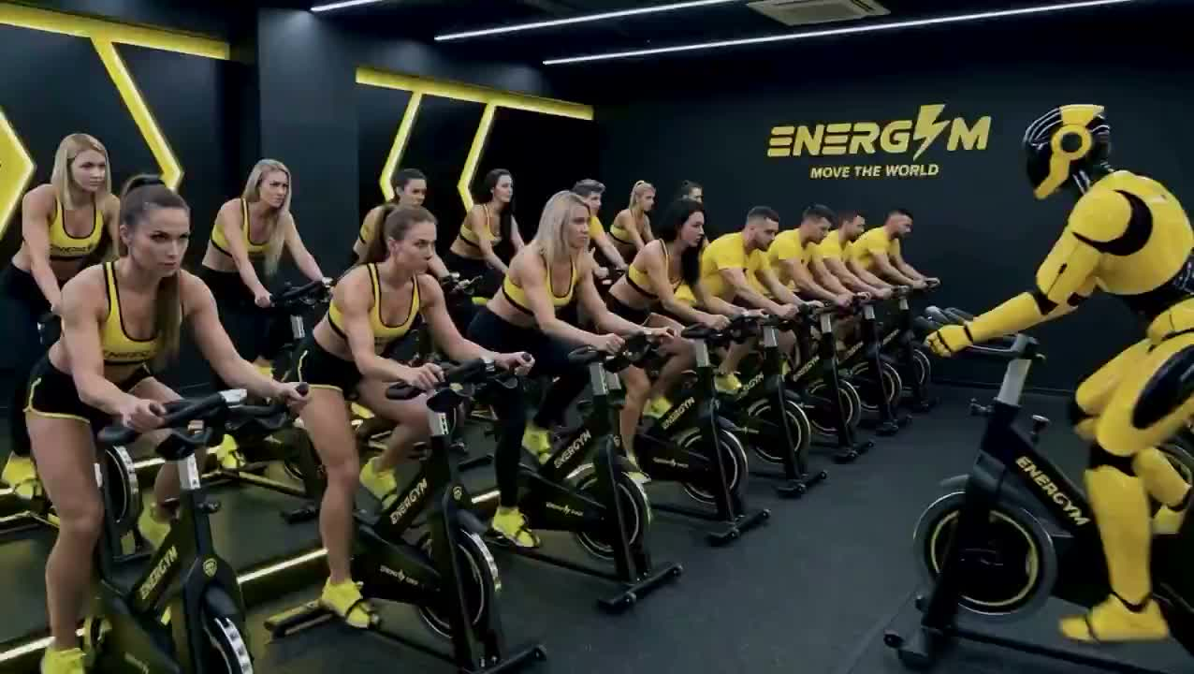
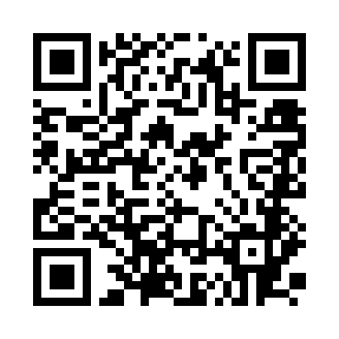
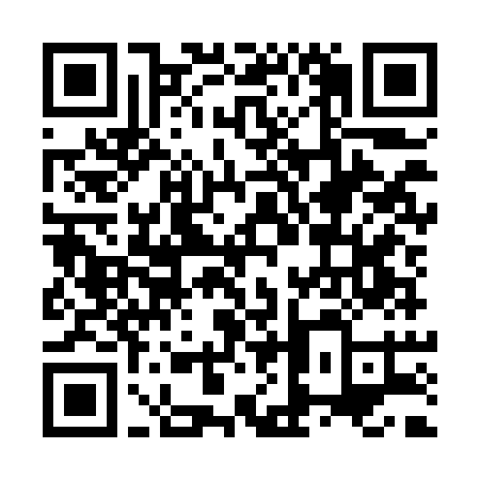
THIS AFTERNOON / HANDS-ON WORKSHOP
AI-generated satire / AI 生成諷刺短片
Direct your
own AI video
親手導演你的 AI 短片
Vibe Filming
Codex + HolyCrab CLI
One idea. Two connected clips.
帶上電腦與一個產品點子
WhatsApp group
Workshop materials
掃碼加入 HolyCrab 群
掃碼開啟講義
ENERGYM / End credit: AiCandy / Shared by @brahma_4u
26 / 27
Notes:
Suggested time 1:10. Introduce for 10 seconds, play the complete 40-second clip, then invite for 20 seconds.
Here is a fictional AI ad about a future we do not have to choose.
After playback: This afternoon, let us use AI to tell our own stories. We will use Codex and HolyCrab to turn one idea into two connected clips. Bring your laptop and a product idea.
中文提示：這是 AI 諷刺短片，片中人物訪談和失業數字屬於虛構，不是真實言論或預測。影片結尾署名 AiCandy；不要稱為 HolyCrab 案例。下午練習兩段相接的短片，不承諾復刻整支廣告。
Source: https://x.com/brahma_4u/status/2098741228108202254
Workshop: https://brucehuang.ai/talks/ai-ultra-video-workshop-2026-09/cli-review/
Join the HolyCrab.AI @ Aiultrafestival WhatsApp group using the left QR code; the right QR opens workshop materials. Both use the existing published workshop links.
左邊掃碼加入 HolyCrab WhatsApp 群，右邊掃碼開啟下午 Workshop 講義。
https://chat.whatsapp.com/EFQX2sWTGokJ8Du4wSLs6u?mode=gi_t

Slide 27
Q&A / 5 MINUTES
Research
Which task
研究模型
How can we demonstrate a new capability?
would you
怎樣證明有新能力？
start with?
Build agents
你準備從哪一件工作開始？
搭建 Agent
How can a system deliver reliably?
怎樣讓系統穩定交付？
Tell us the task and where it gets stuck
Apply AI
説説具體工作，以及最卡的一步
We can work backward from the result
業務應用
從想要的成果倒推做法
Which part of my work should I begin with?
我的工作從哪裏開始？
brucehuang.ai / Bruce Huang
OpenClaw Asia / HolyCrab.ai
AI Ultra Festival / September 13, 2026
27 / 27
Notes:
Suggested time 5:00
Visual: Questions that begin with real work
Let us begin with a concrete task. What do you do today, which part would you like an agent to take on, and where are you worried it might fail? I will try to answer in terms of the working environment, the materials and the check. If the question is which product is best, we can first establish what actions the task needs. If the question is about a career, let us look at the responsibilities within it.
中文提示
先請大家帶着具體任務提問：現在怎樣做，想交給 Agent 哪一步，最擔心哪裏出錯？我會優先從工作入口、材料和驗收方法回應。
如果有人問哪個產品最好，先確認任務和權限。如果有人問是否會取代某個職業，把討論落到具體步驟、責任和需要保留的判斷。
Sources

